Slide 1


Pre-Physician Assistant Society: Fall 2025 GIM
Brooke and Bryan
Attendance!

Slide 2
About Our Club!
We are a peer resource for Pre-PA students at Binghamton University!
  PPAS provides support to students along with pre-health advising
Our club has been chartered by the SA since 2014
Our goals:
  Explain a PA’s role in the medical field
  Provide guidance in every way possible including class scheduling aid, CASPA season help and PA school interview prep, and local patient care job information- anything to support our Pre-PAs at BU
  Create a compassionate and collaborative environment between members who are going through the same experiences and can relate to one another!
  Describe the difference between PAs and other medical providers including NPs, MDs, etc.
  Host volunteering opportunities and allow members to network with alumni, local PAs and current PA students.
Notes:
Explain what PPAS is, the goals of our club, how long we’ve been a club, and anything else that will help people understand PPAS

Slide 3
What is a PA (Physician Assistant)?
PA stands for Physician Assistant/Physician Associate
PAs work interdependently with doctors, and can even own their own practice under a supervising physician in some states.
PAs have a lot of autonomy when practicing!
  The duties of a PA are dependent upon experience level, specialty, and the work setting of the individual (Private Practice, Private PA, Clinic, Hospital, etc)
  In general, PAs can: take medical histories, conduct assessments, diagnose and treat illness, develop and manage treatment plans, prescribe medications, perform procedures, and assist in surgeries
To become a PA, a master’s level PA program is required. These are typically 2-3 years in length with unique application requirements for different schools.
PA education follows the medical model rather than the nursing model
There is the existence of lateral mobility within the profession due to its rigorous schooling (very unique compared to other professions)
Notes:
Include the basics on what a PA does, their scope of practice, how much education it is, interdependence and lateral mobility, etc etc

Slide 4
How is PA school different from other provider’s schooling?
PA School
Medical School
Nurse Practitioner School
PA school applications are more focused on healthcare experience rather than testing (Require PCE to apply!)
2-3 years total
Medical schools tend to be more focused on GPA and MCAT scores
Longer schooling- 4 years- plus residency/fellowship (3-7 years on average)
NP is based on the nursing model
Requires a BSN and work experience before applying
2-4 years of schooling
Notes:
Compare the 3 common routes. Explain how PA school is different. You may want to include differences in length of specialty, different scopes of practice, application requirements, PA school teaching style, etc.

Slide 5
Common Prerequisite courses for PA school:
PA schools can differ greatly in the prerequisites they require, but here are the most common:
Intro Biology w/lab: (BIOL 113, BIOL 114, BIOL 115(lab))
Intro Chemistry w/ lab: (CHEM 107 & CHEM 108, or CHEM 104/105/106)
Organic Chemistry I & II: (CHEM 231 & CHEM 332)
  Organic Chemistry lab: (CHEM 335) is required by many schools!
Biochemistry (BIOL 304: Pre-health Biochem, BIOL 403: Regular Biochem)
  *many schools will take orgo in place of biochemistry!*
Anatomy & Physiology I & II w/ lab (BIOL 251 & BIOL 347)
Statistics (MATH 148: Biostats or MATH 147: Statistics or PSYC 243, varies by school)
Microbiology (BIOL 319: Pre-Health Microbio or BIOL 314: General Microbio)
Genetics and or Cell Biology (BIOL 332/ BIOL 311)
Some schools require Medical Terminology (CLAS 121)*
Other classes such as Writing, Literature, Psychology, etc vary from school to school.
  English: 2 courses from ENG, RHET, WRIT, CW, COLI
  Arts and Humanities: history, language, etc
  Social/ Behavioral Sciences: sociology, anthropology, psychology

Slide 6
What is Health Care Experience?
Healthcare experience (HCE) is any work or volunteering in a healthcare setting where you are not directly responsible for a patient. Some schools require HCE.
Healthcare experience is required by most PA programs. The emphasis on prior patient-care experience (PCE) is the main difference between the Pre-Med and Pre-PA track
Patient care hours include working as a CNA, EMT, Physical Therapy Aide, Patient Care Technician, Medical Assistant, Phlebotomist, etc.
  Most of these require a certification (but not all!)
The number of required patient care hours varies depending on the program
  SUNY Upstate: 1000 hours
  St. John’s: no specific amount, but hours are strongly recommended
Some schools consider shadowing and volunteering towards your PCE or HCE, while others don’t :(
Don’t worry! We’ll have another meeting just about PCE vs HCE and how to get it!
Notes:
Define HCE, PCE, and state the difference between the two
Explain that PCE is a requirement for PA school, give examples of ways to get PCE, and explain how amount of hours varies from school to school

Slide 7
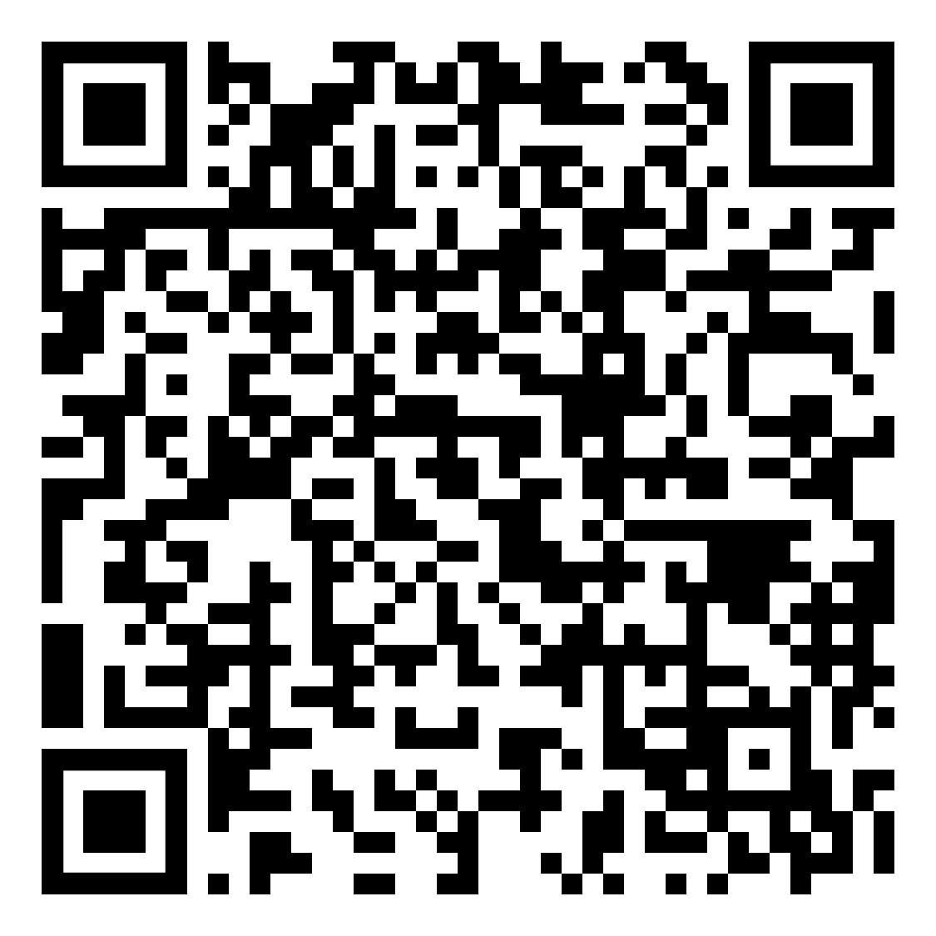
Not all PA Programs are the Same!
It is important to start looking into PA programs early so you know what each one requires
Some of the main classes PA program requirements vary in are Orgo/BioChem, Microbio, Calc, Genetics, and Med Term
  Most of these are difficult classes so you will want to know if you need to mentally prepare for them or don’t have to worry about them!
PA schools require different amounts of Patient Care Hours
  Ranges from 0 to 2,500 hours
  Some schools accept shadowing and/or hospital volunteering as PCH
Some schools require the GRE
PA programs vary in length
  Range from 24-36 months
  Longer programs usually have more breaks
DON’T WORRY! You can find all this information on our PA Program Database!!
Here’s a link to our PPAS Program Database, where you can view different programs and filter choices based on different requirements
PPAS Program Database
Notes:
PA programs have different requirements (classes, hours, exams, etc, depending on the program) stress the importance of researching schools early to know what you need to complete for each one’s application)

Slide 8
Additional Hours and Experience!
Many schools require/recommend shadowing PAs to gain experience and exposure to the PA career. Most schools also require a Letter of Recommendation from a PA
Shadowing other professions (RN, doctor) along with PAs can show you the difference between their roles and help determine if becoming a PA is right for you
Besides patient care hours, many schools also like to see healthcare experience and non-healthcare volunteering
  Some places to get volunteer hours are:
    Soup kitchens or food pantries
    Animal shelters (PPAS volunteers with Broome County Humane Society!)
    Nursing homes or hospitals
There are also many opportunities to go abroad on medical mission trips with programs like MEDLIFE or study abroad shadowing programs through organizations such as Atlantis
TIP: Volunteer in a passion of yours!
Notes:
Include info about letters of rec, community service, shadowing, and ways to get these things

Slide 9

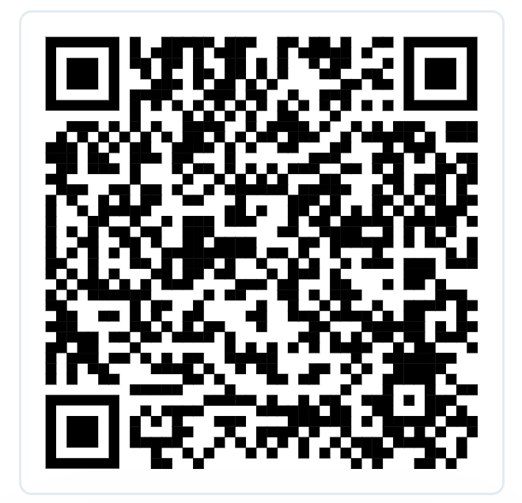
New volunteering opportunity
Volunteer Application
Interest form

Slide 10
GRE and other Exams
The GRE
  Its purpose is to measure a student’s readiness for graduate school
  Approximately 2 hours in length with a focus in three main areas:
    Vocabulary
    Analytical Writing
    Mathematics
  It sounds scary, BUT the good news is that not many school require this test anymore !!
    Alternatively you could only apply to schools that do not require the GRE
The PA-CAT
  Comparable to the MCAT for medical school and the DAT for dental school
  This exam would be more specialized and focused on key science prerequisite courses
  Fairly new, very few schools require it right now
The CASPer
  An open-response situational judgment test that measures aspects of your social intelligence and professionalism, like ethics, empathy, problem-solving and collaboration (skills that can’t be qualified by traditional academic assessments)
  Presented with a variety of written and video prompts involving difficult situations and asked what you would do in each situation
  90 to 110 minutes
Notes:
Discuss GRE, PA-CAT, and CASPer

Slide 11
CASPA and Applying to PA School
CASPA (Central Application Service for Physician Assistants) is like the common app for PA schools
  90% of PA programs use CASPA
Timeline: If you don’t want to take a gap year, you would apply in Spring of Junior year and would be accepted for the following summer semester.
  You could possibly be starting PA school right after graduation depending on the program.
On average, PA school applicants apply to 8-12 schools
Application portal usually opens in late April, but you can start filling in information prior.
  Once the cycle closes you will lose everything you entered so either save it in a Doc or you can have CASPA re-enter your information
The earlier you apply in the cycle the better, especially to schools with rolling admissions
Next semester we will be having a CASPA workshop with alumni!
Notes:
Discuss CASPA/process of applying to PA school and application timelines

Slide 12
Get to know our 2025-2026 E-Board!

Slide 13
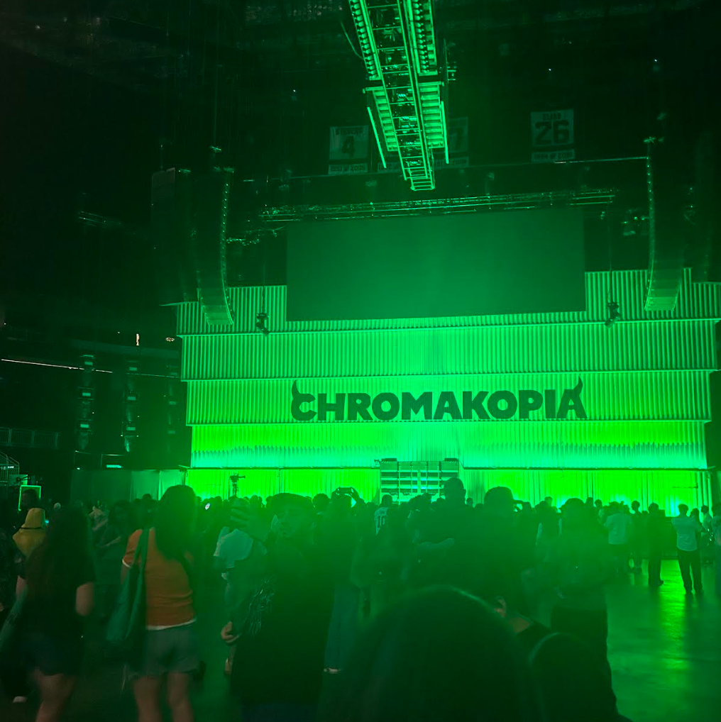
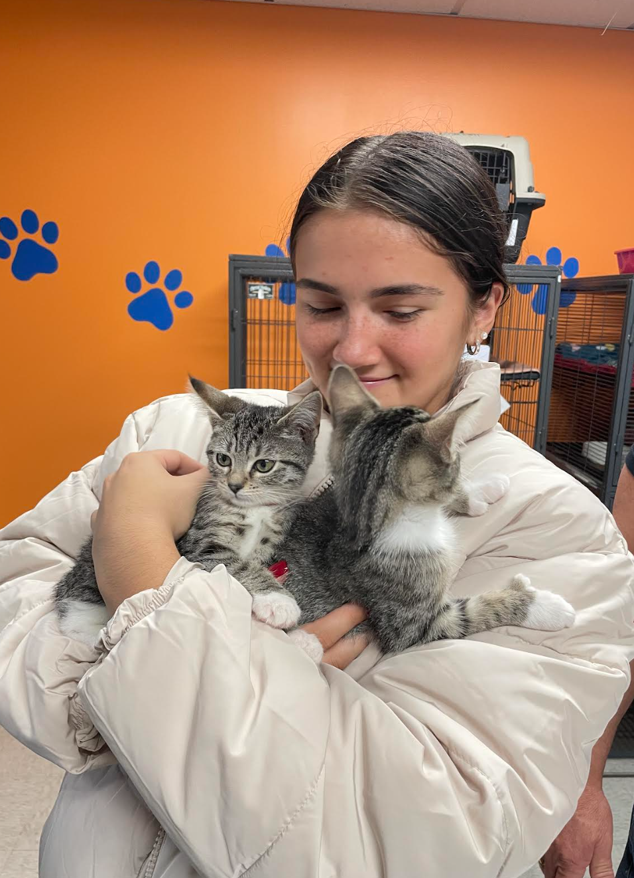
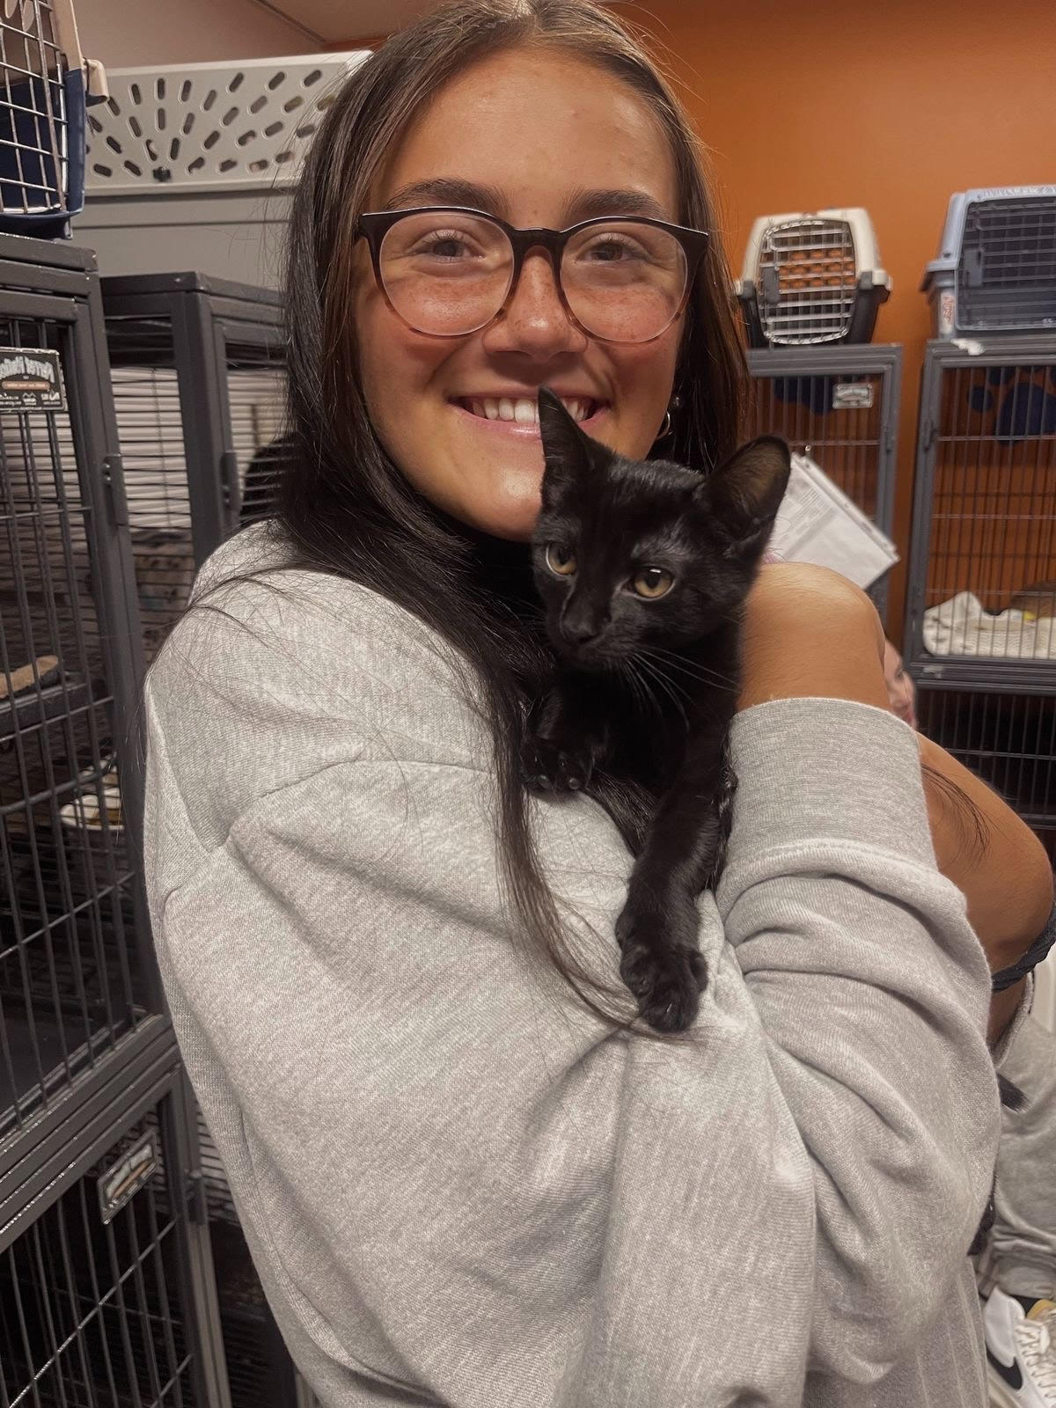
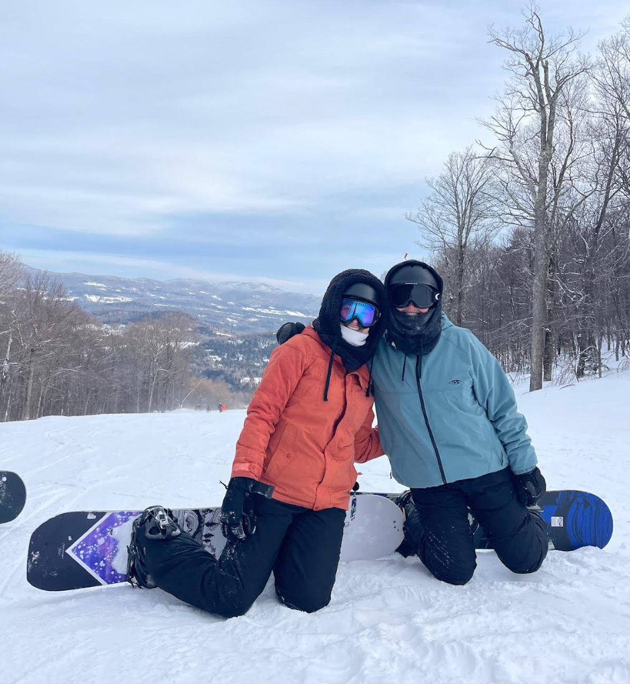
President: Brooke
Year: Senior
Major: Biology
Minor: Spanish
PCE: PCT at Lourdes Hospital, CNA
What PPAS has given me:
  The ultimate support system
  A network of alumni who give back to PPAS
  A great resumé builder
Extracurriculars:
  This :D
  Anatomy & Physiology TA (previously did BIOL 115)
  Program Assistant/ Consultant at the BU Speaking Center
  Shadowing (Urgent Care, OR, Neuro ICU)
  Member of Phi Sigma Iota (Foreign Language Honor Society)
  Broome County Humane Society
Fun Fact: I snowboard

Slide 14
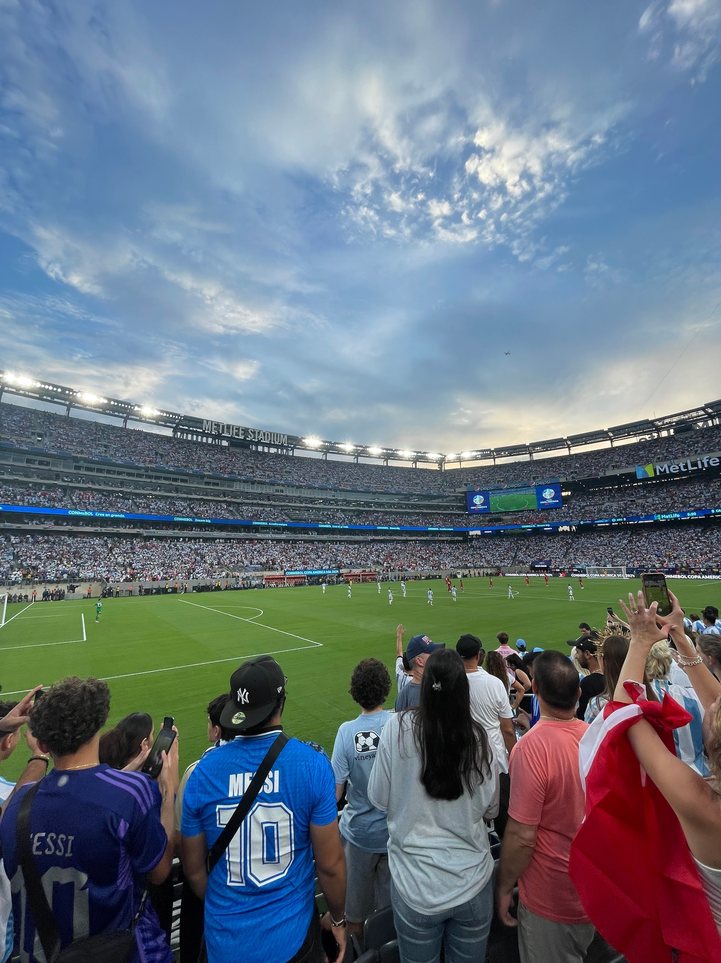
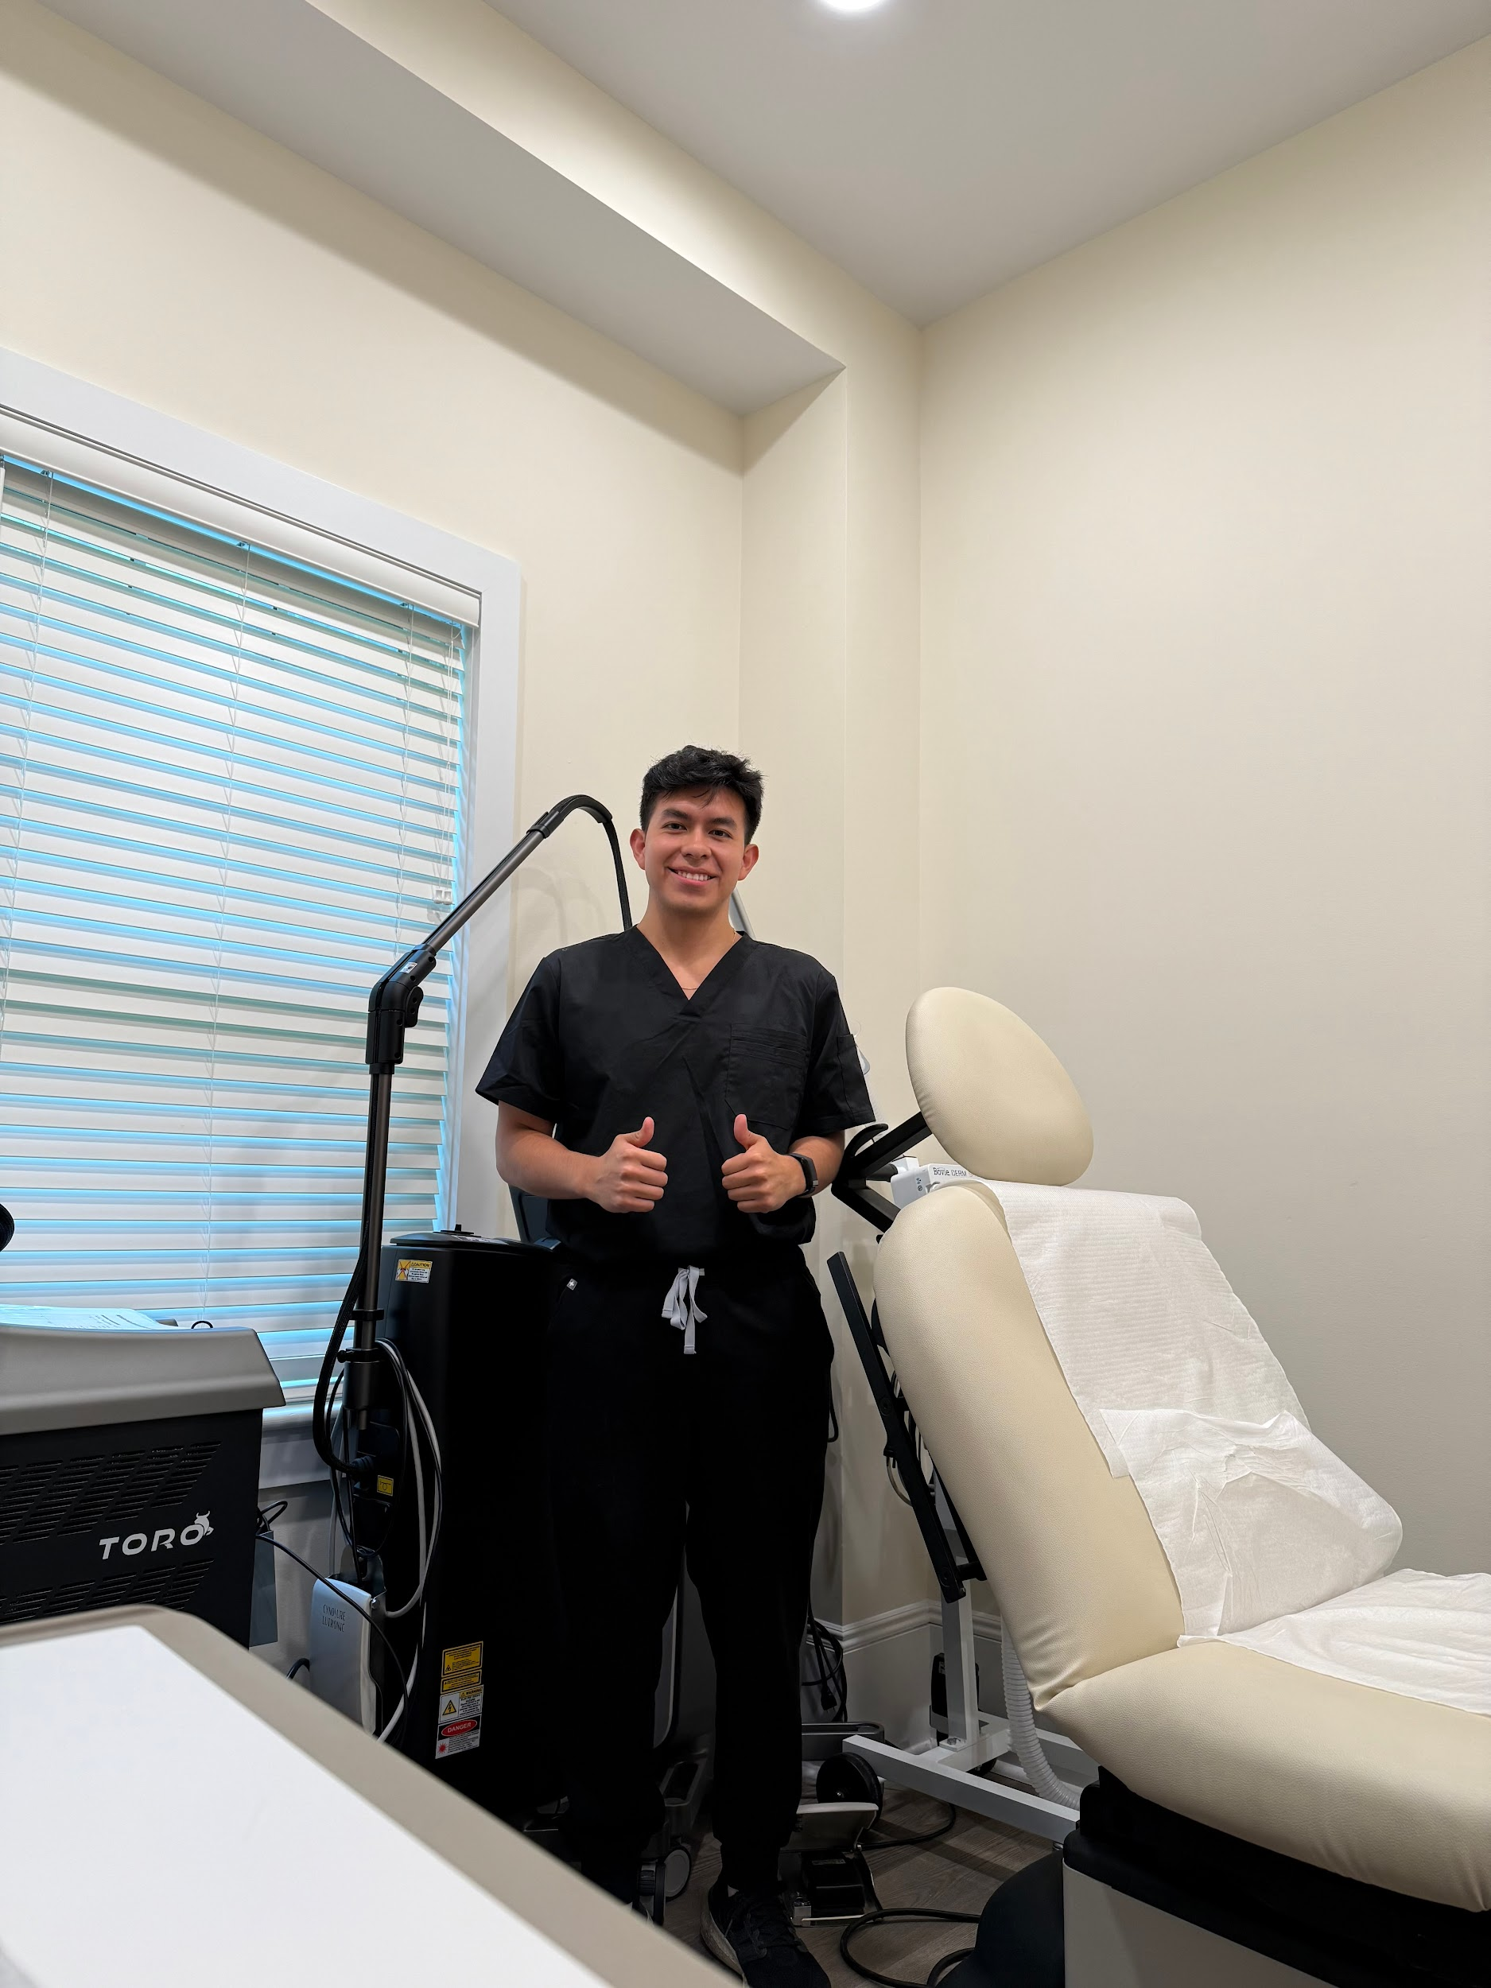
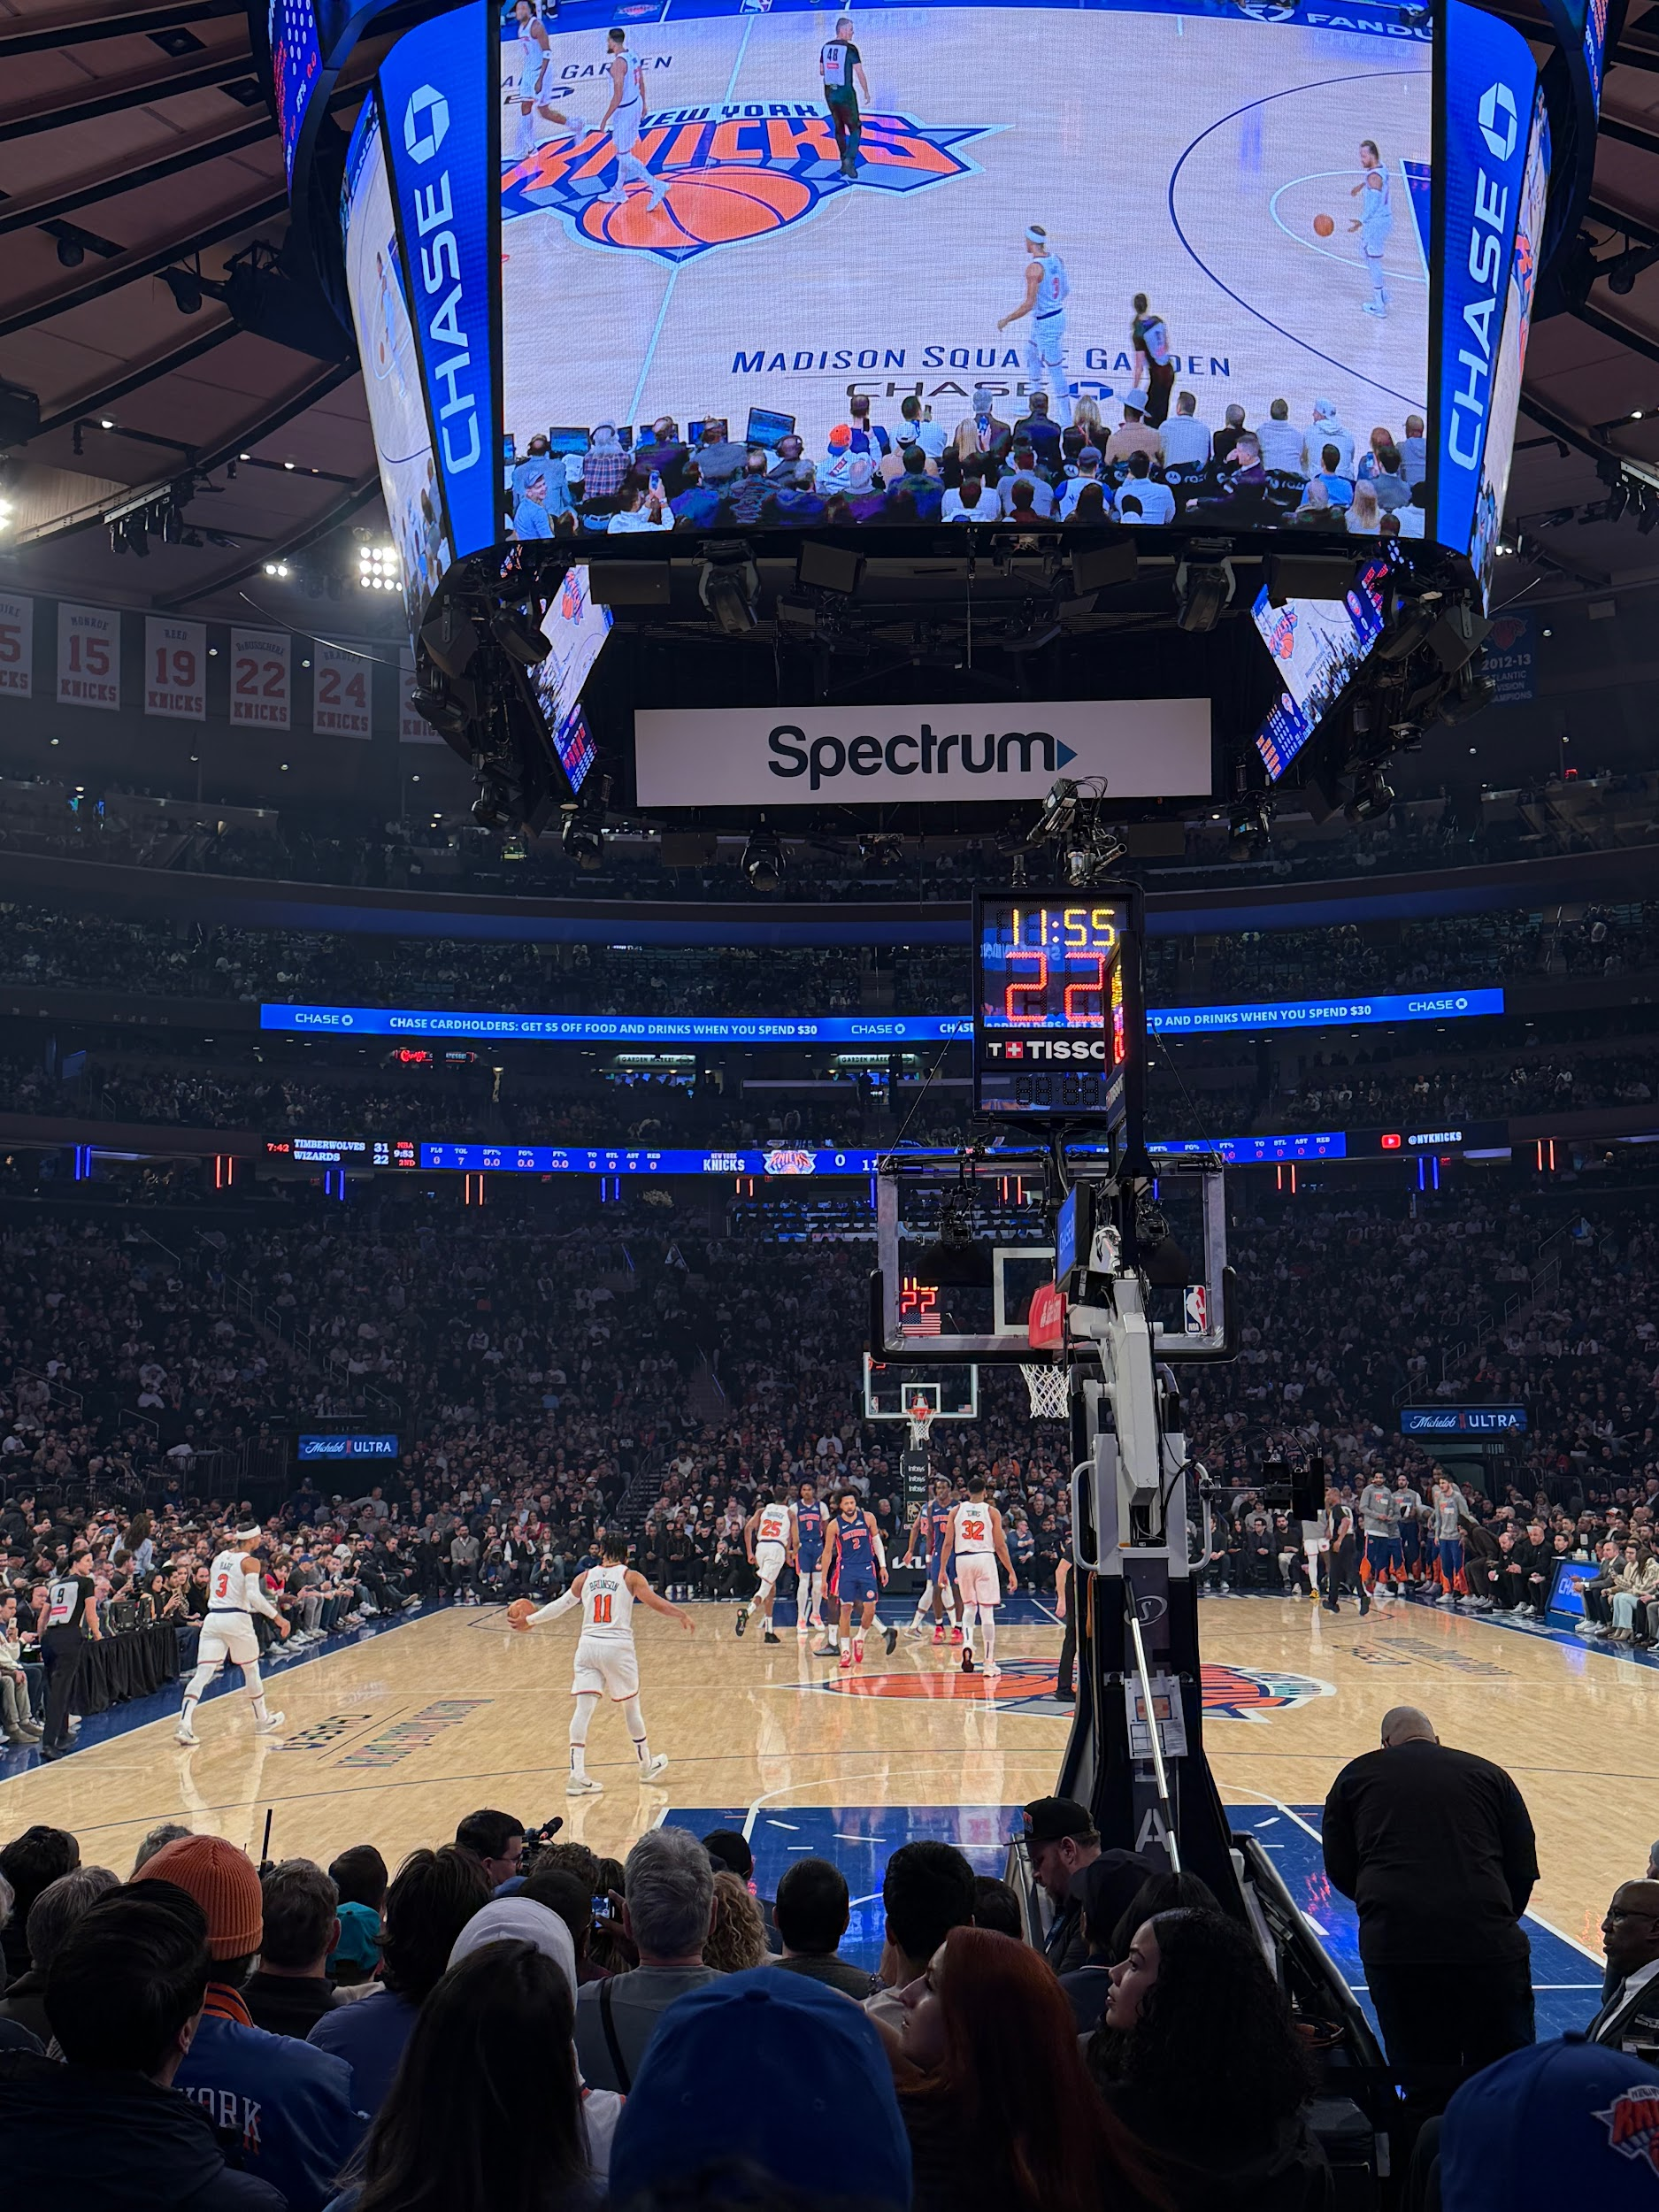
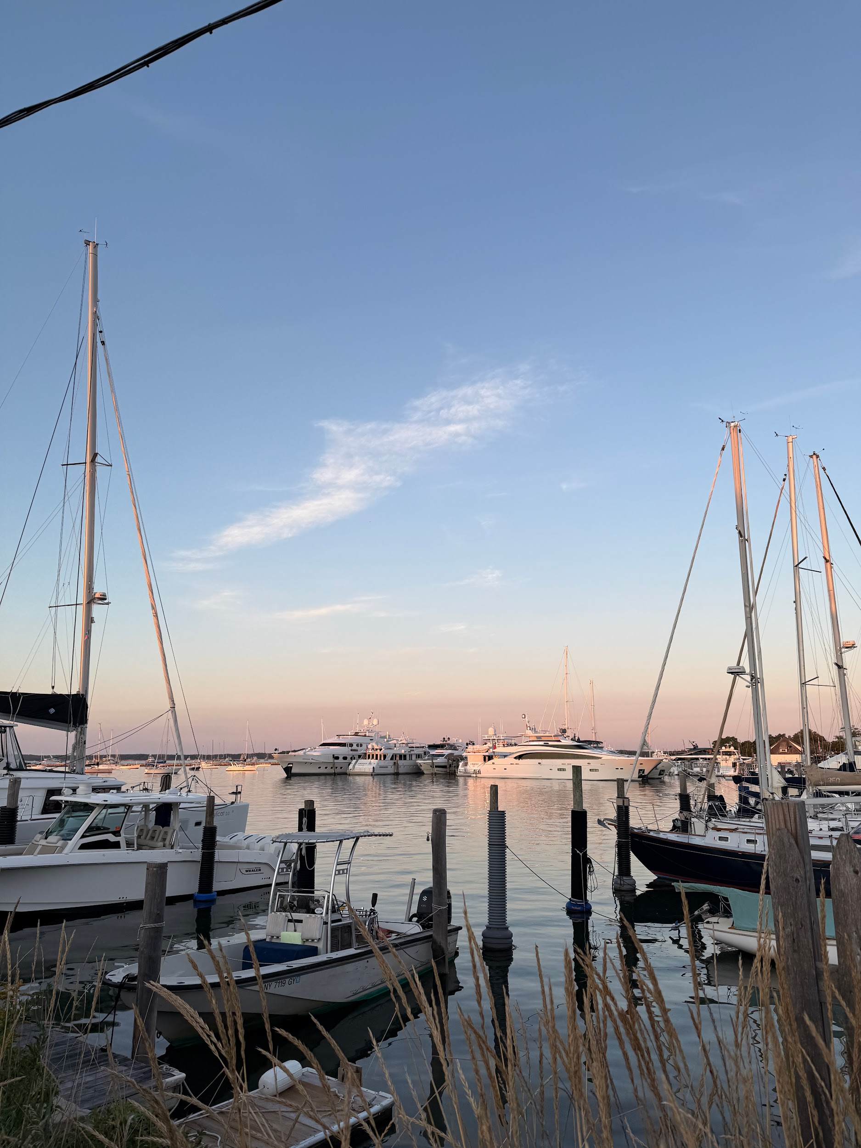
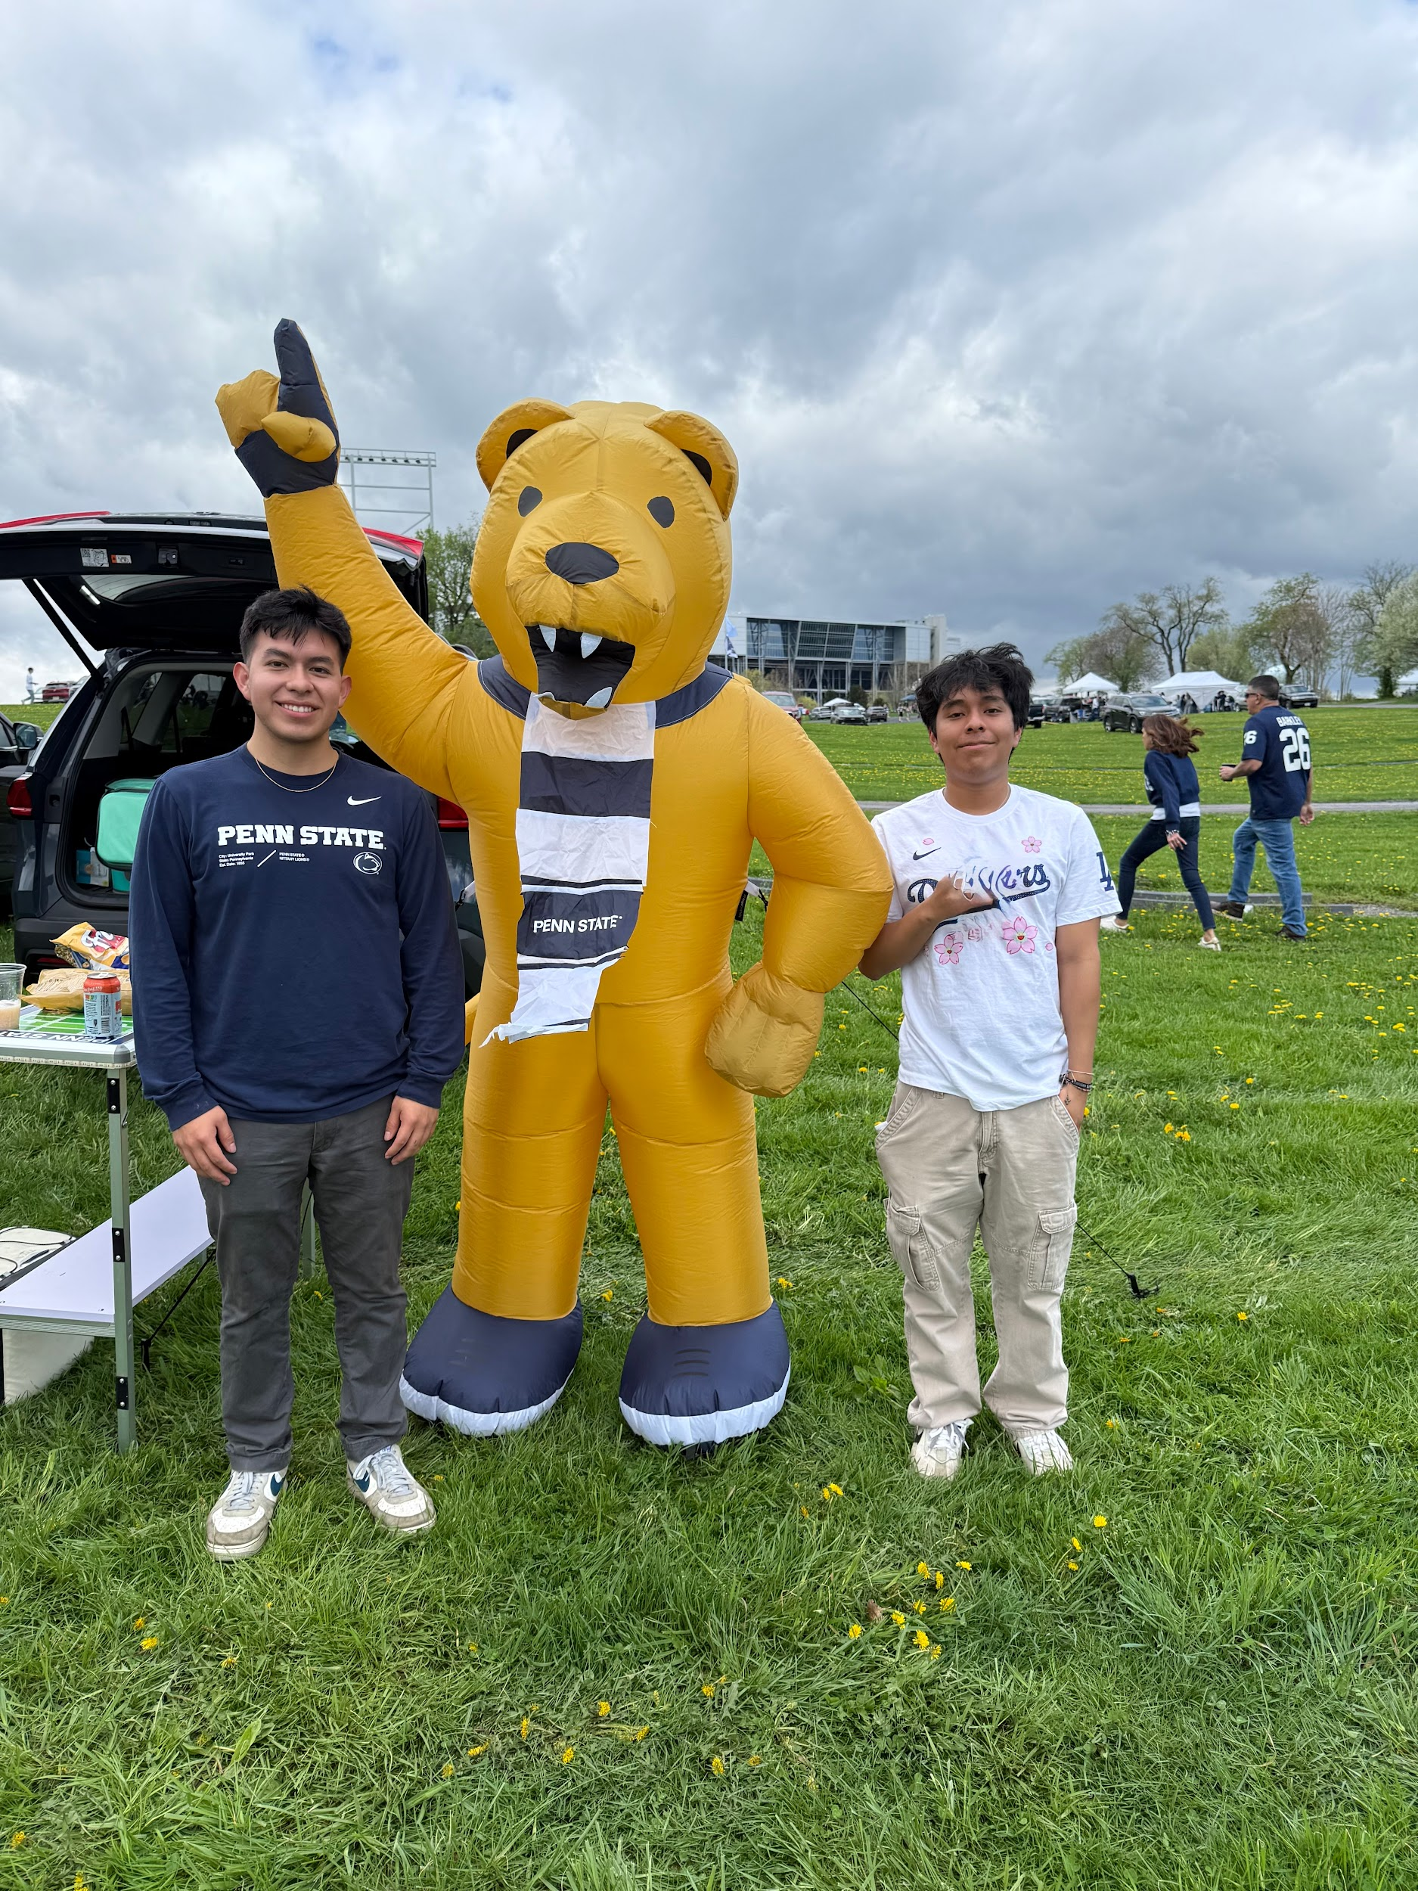
Vice President: Bryan
Year: Senior
Major: Biology
PCE: Medical Assistant
What PPAS has given me:
  Welcoming community of like-minded individuals with a support system of students in the same position as me!
Extracurriculars:
  PPAS (ofc)
  Broome County Humane Society Volunteer, ALPFA, Medicine in Sports
  Shadowing (Derm, Ortho, Peds)
Fun Fact:
  There is a 17 year age gap between me and my baby sister!

Slide 15

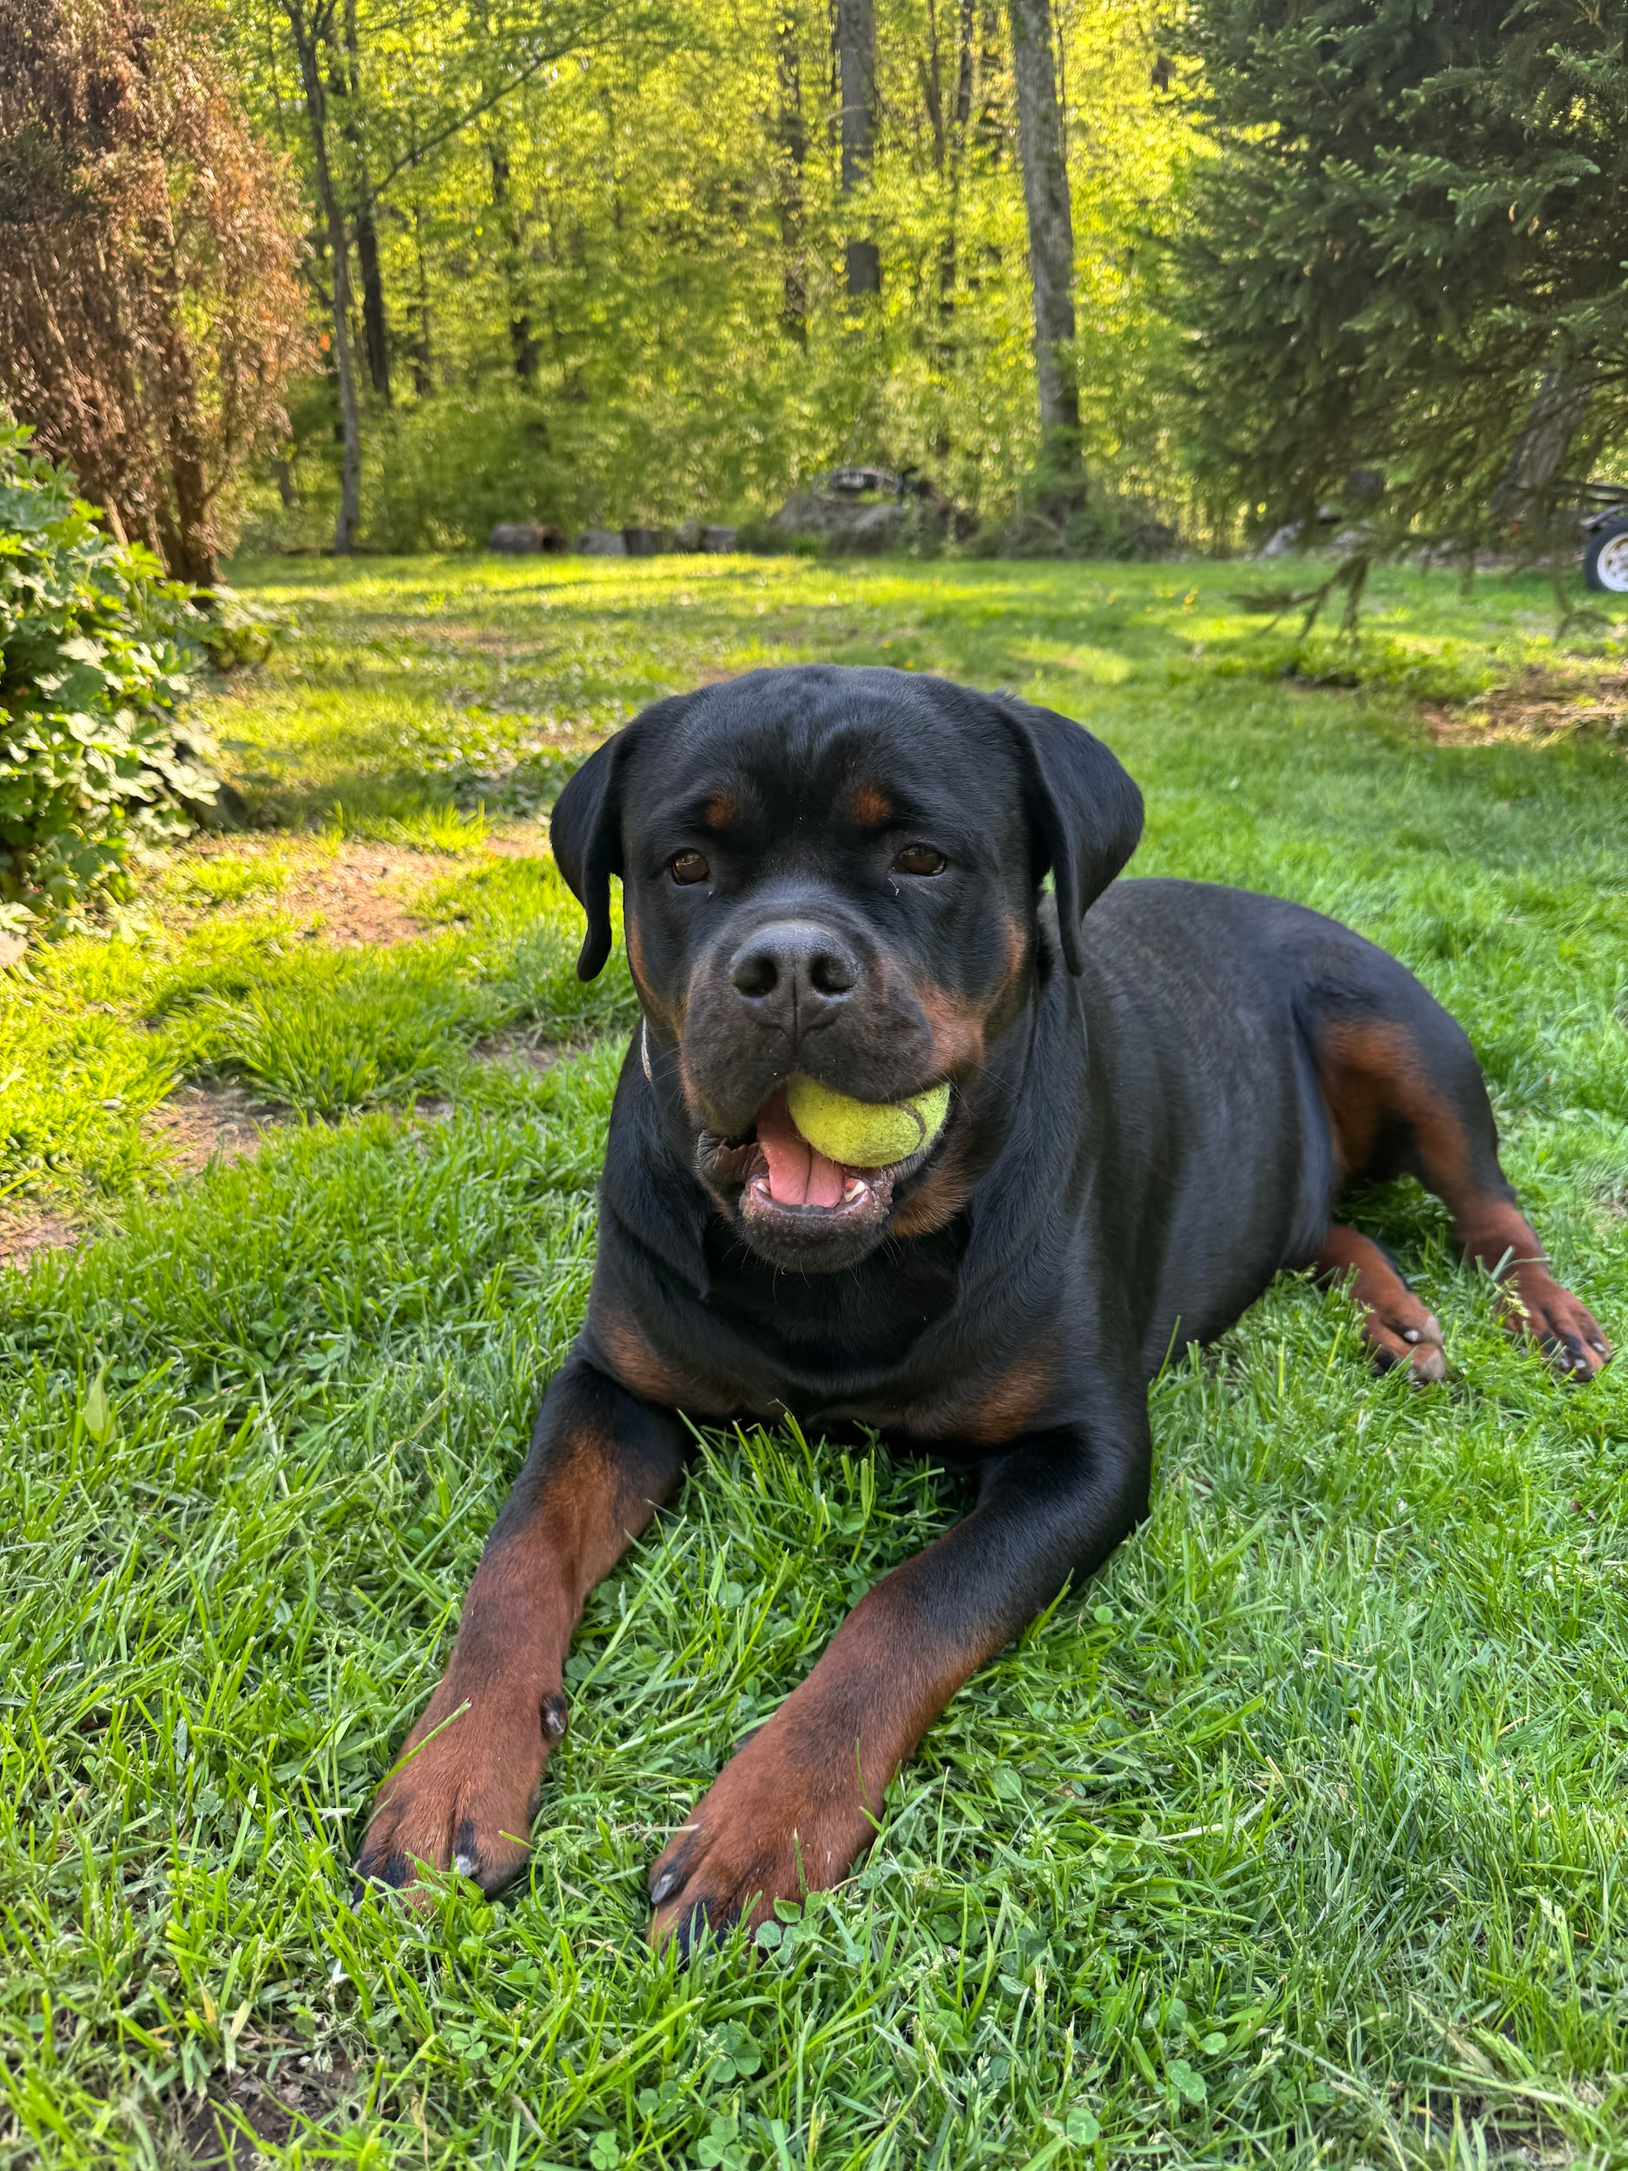
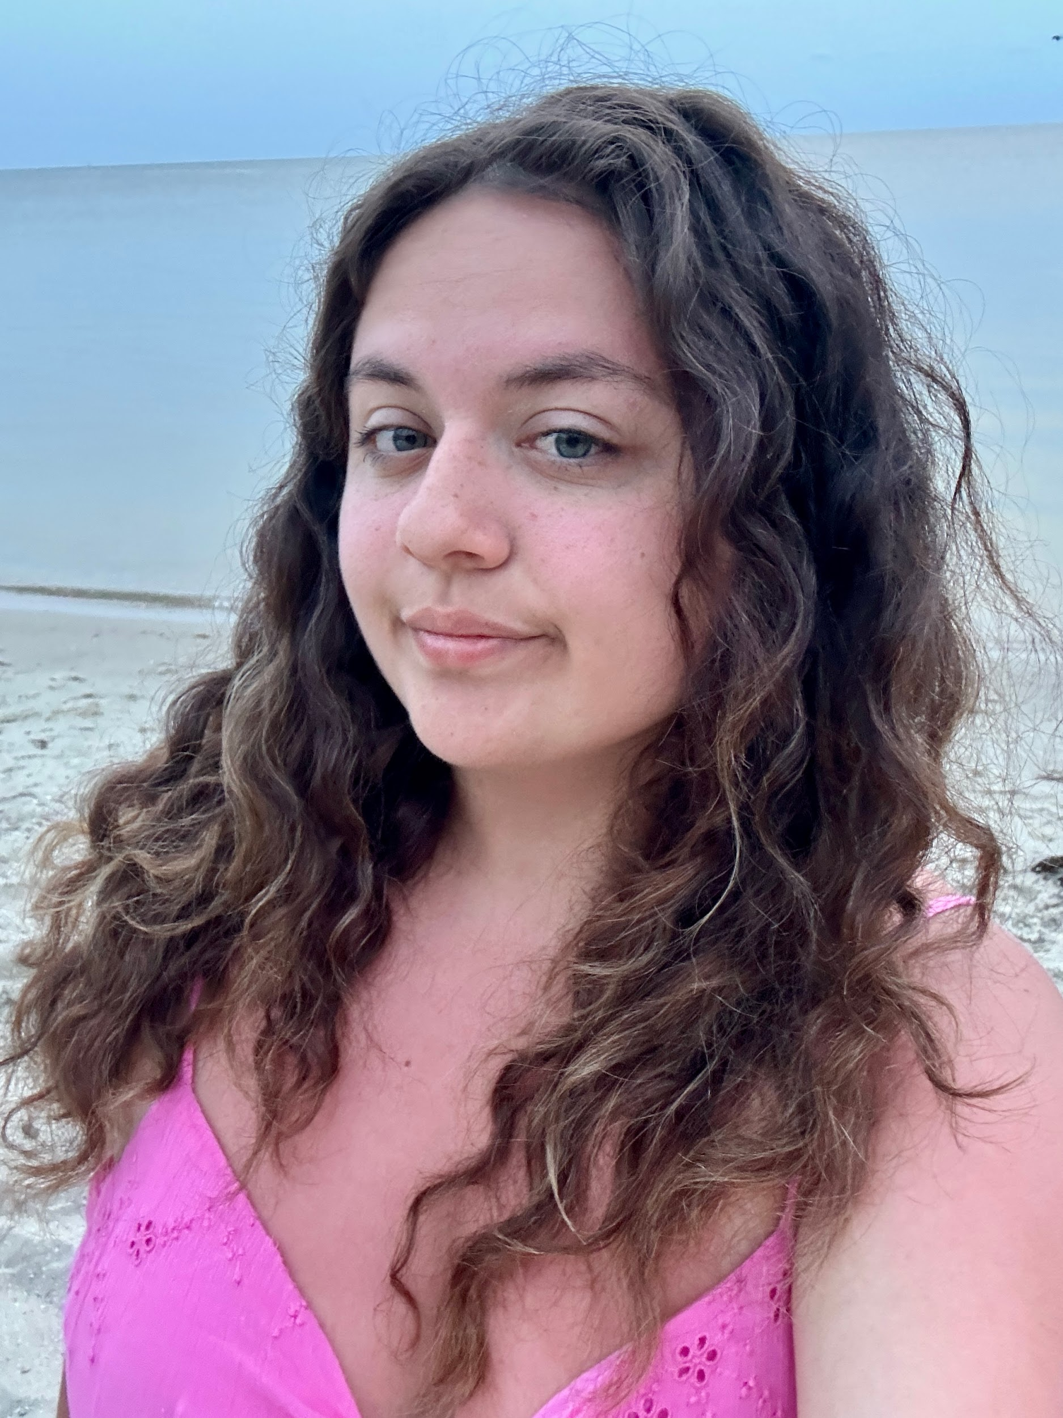
Vice President: Jenna (Fall)
Year: Senior (graduating this semester 😓)
Major: Biology
Minor: Health and Wellness
PCE: CNA
What PPAS has given me: The best support system with a continuous stream of new knowledge
Extracurriculars:
  PPAS obvi
  Binghamton Aiding Hearts Outreach Chair
  UTS CHEM 105 tutor
  OPhiA member
  7 brew brewista 😛
  Transfer student mentor
  Broome County Humane Society volunteer
  Shadowed PAs in gastroenterology & hematology & oncology
  TA experience in: anatomy and physiology 1&2, BIOL 113, CHEM 104
Fun Fact: I can make a dolphin sound

Slide 16
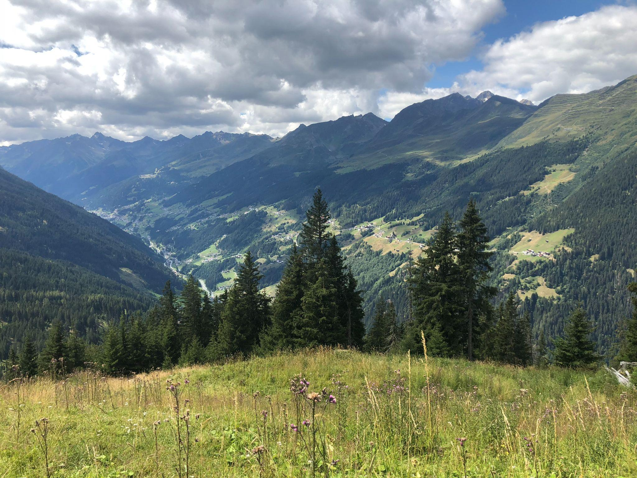
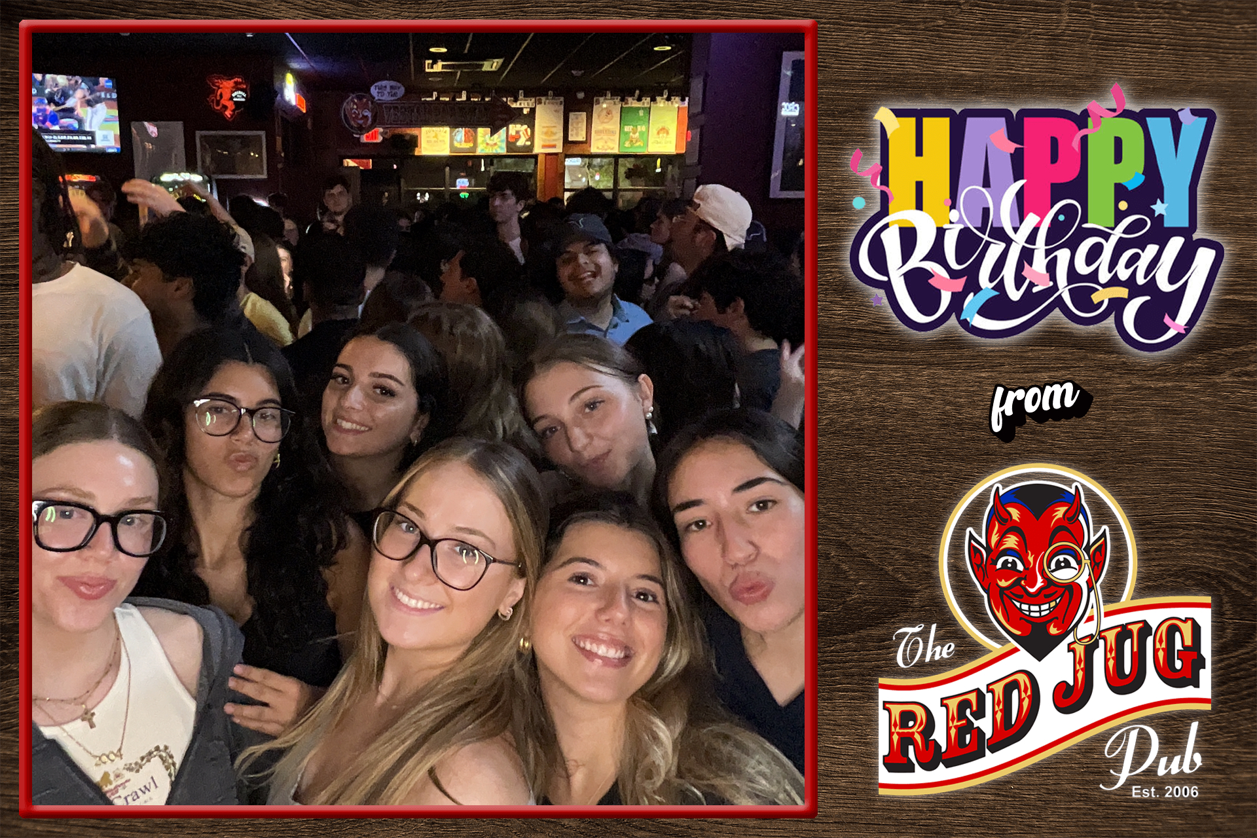
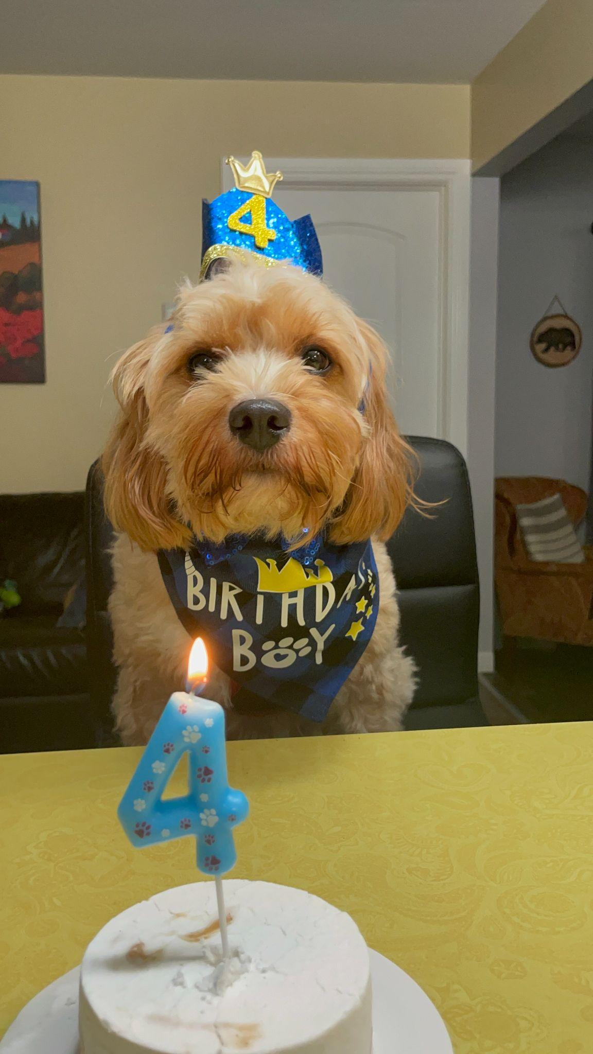
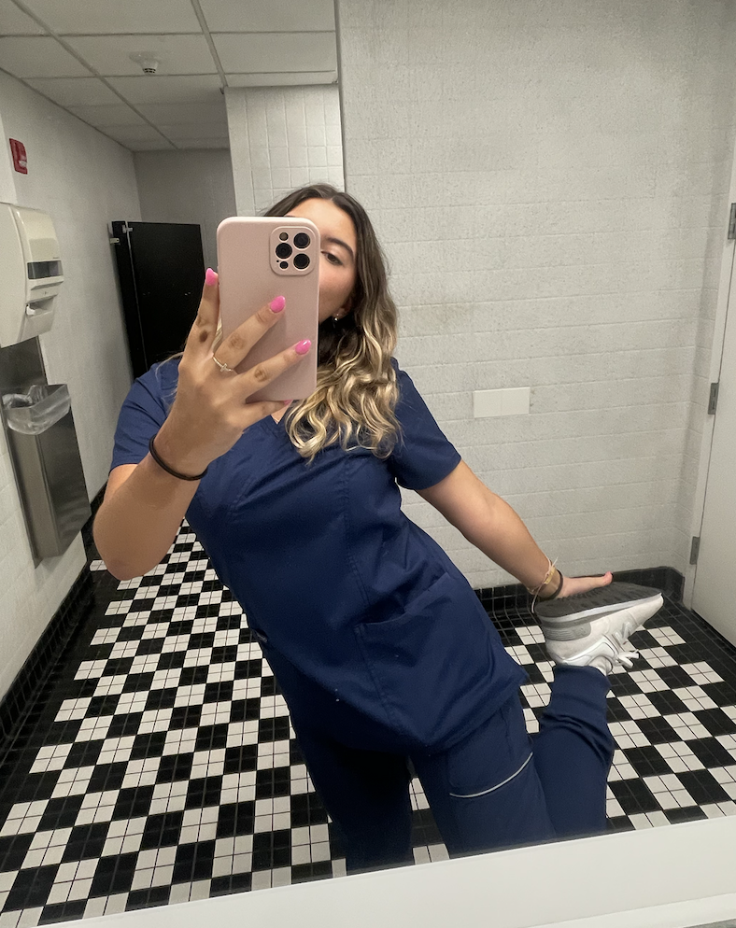


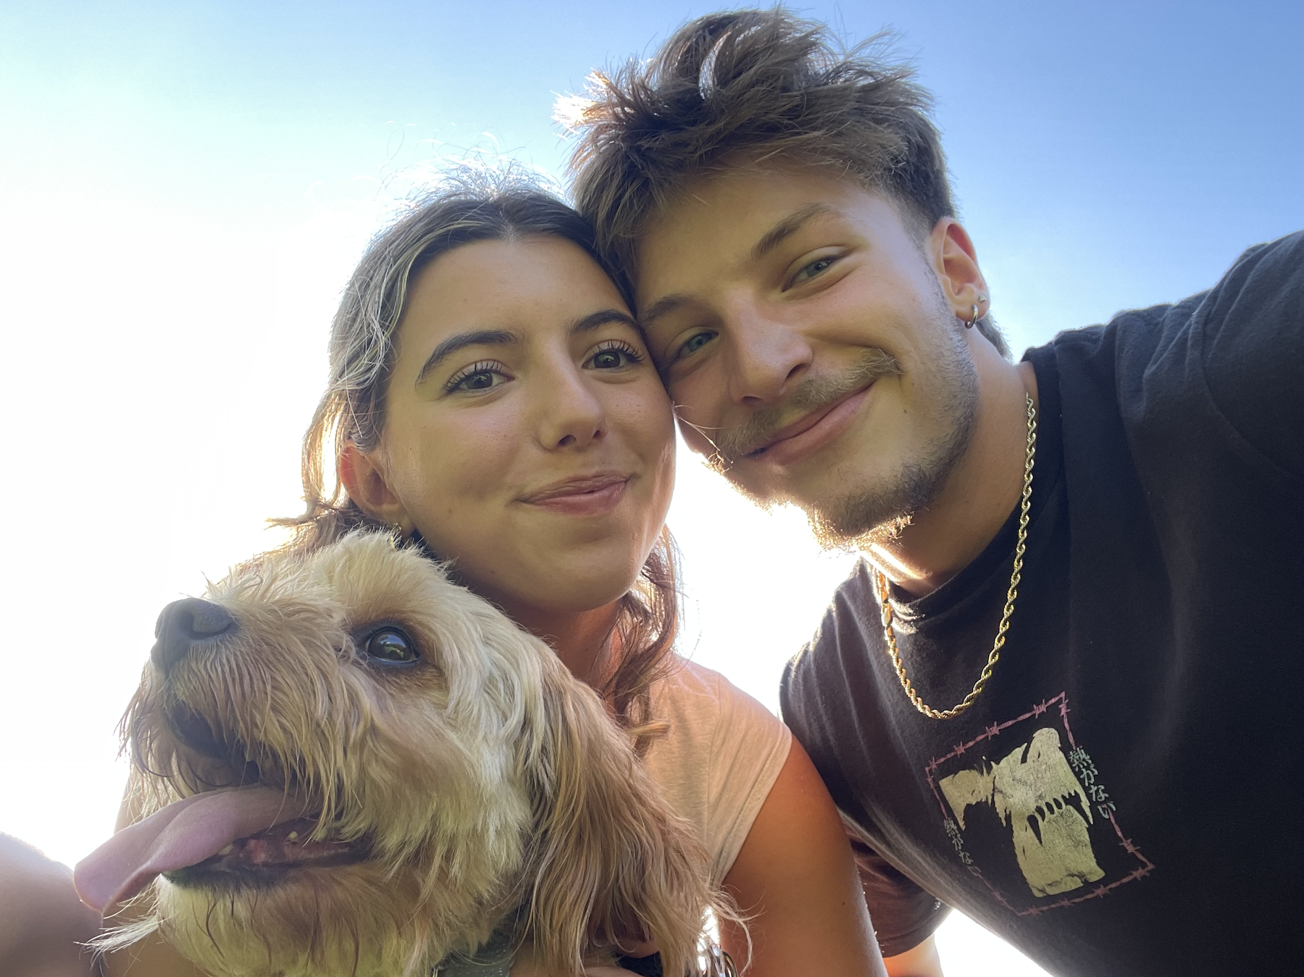

Vice President: Adriana (Spring)
Year: Senior
Major: Integrative Neuroscience
Minor: HWS
PCE: MA
What PPAS has given me: The extremely supportive community, pool of infinite advice, and meeting pre-pa friends
Extracurriculars:
  PPAS :)
  Students for Sunrise
  Shadowing: vascular surgery & derm
  Broome County Humane Society
  Study Abroad volunteer advisor when I get back!!
Fun Fact: I speak Romanian!

Slide 17
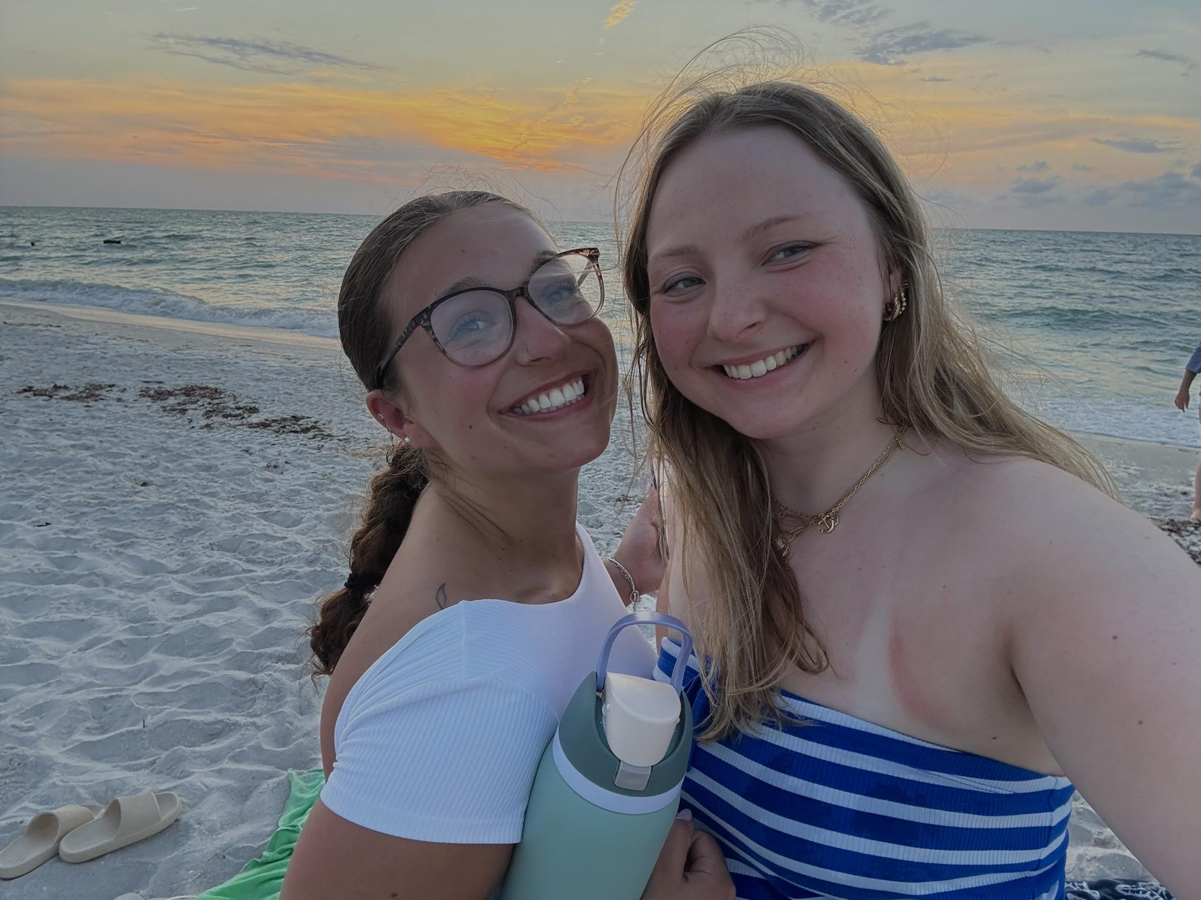
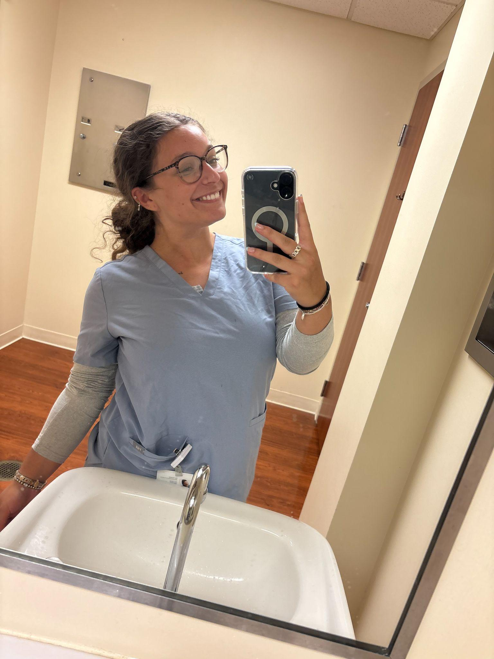
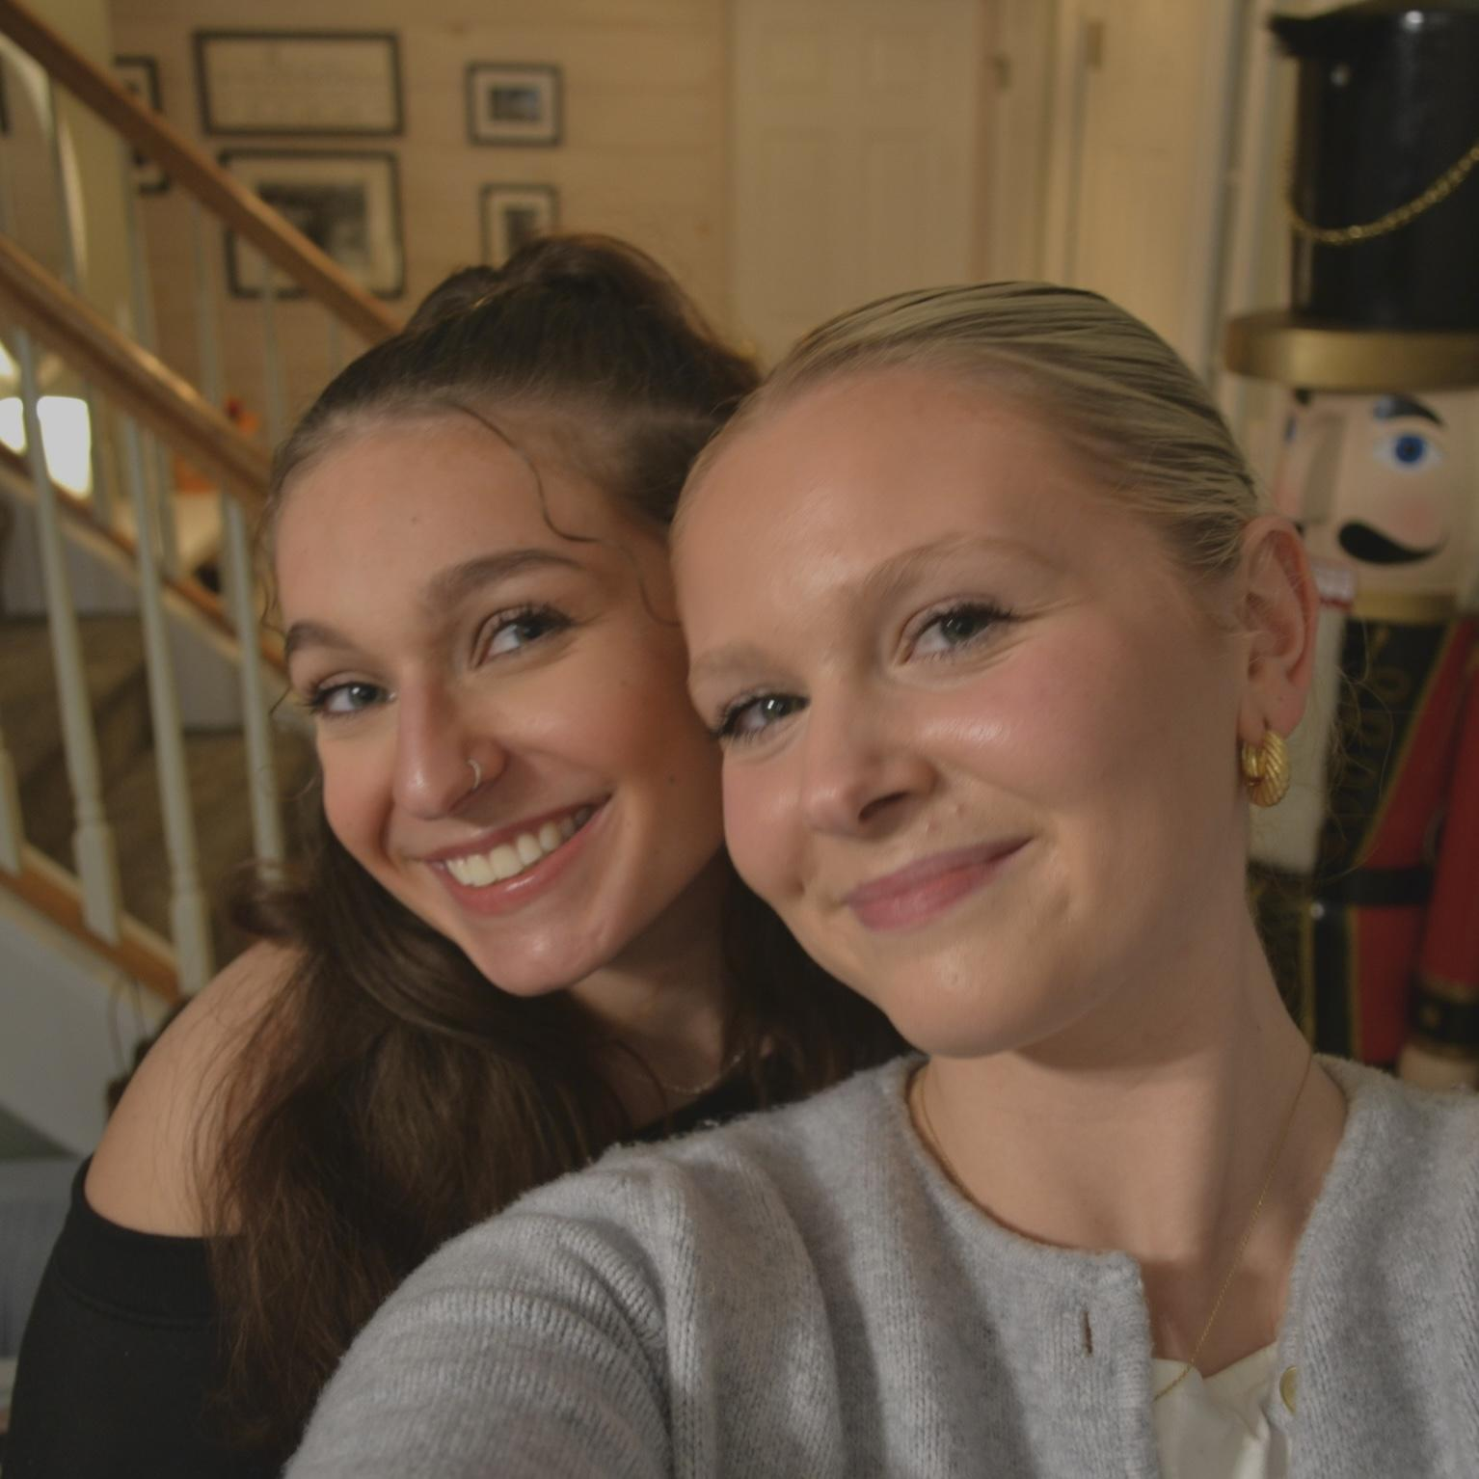
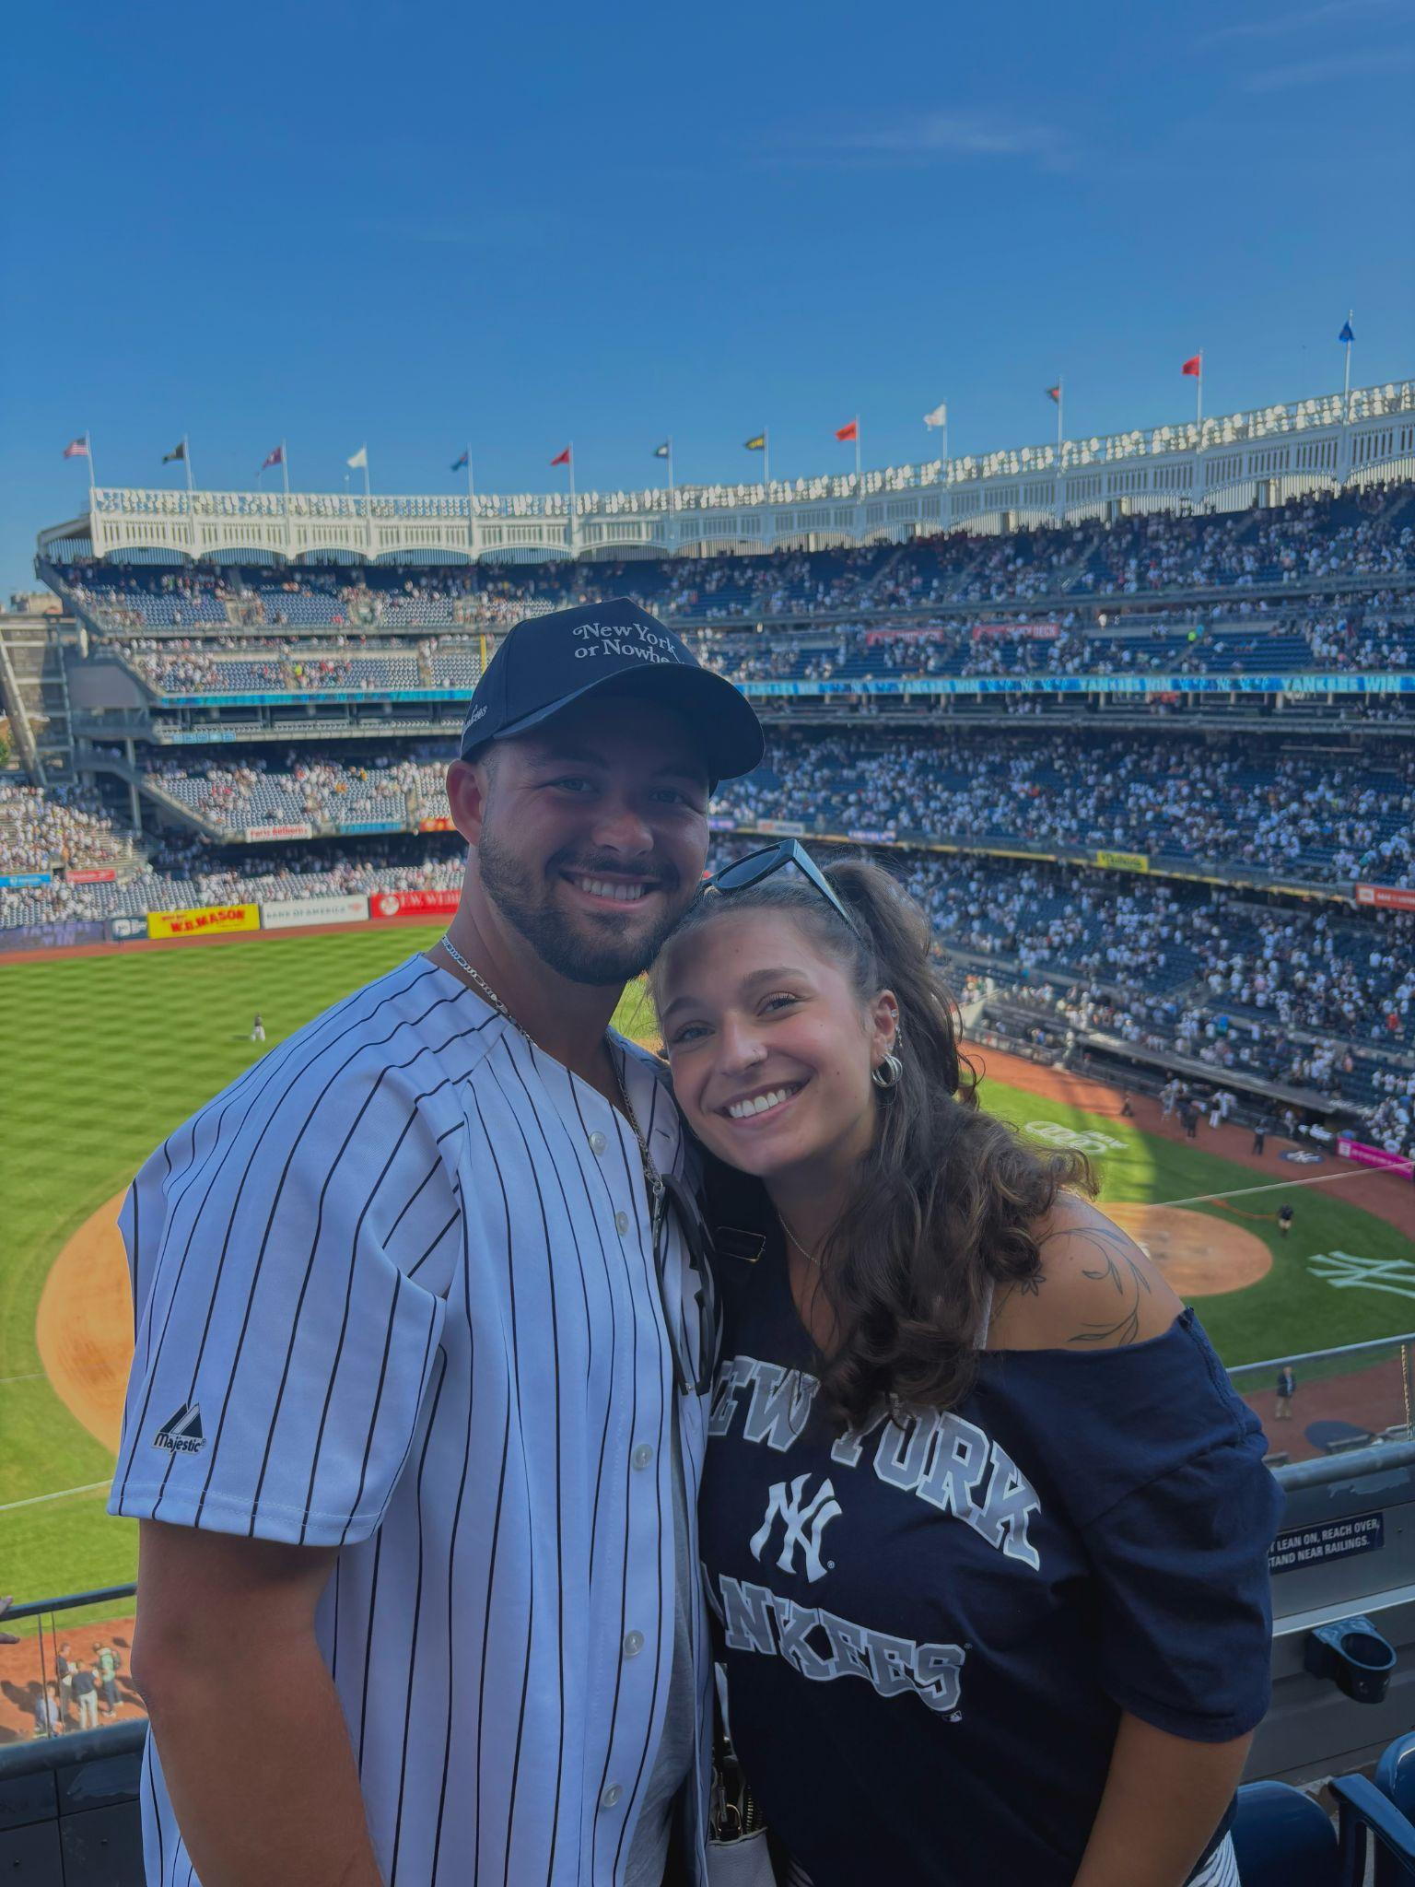
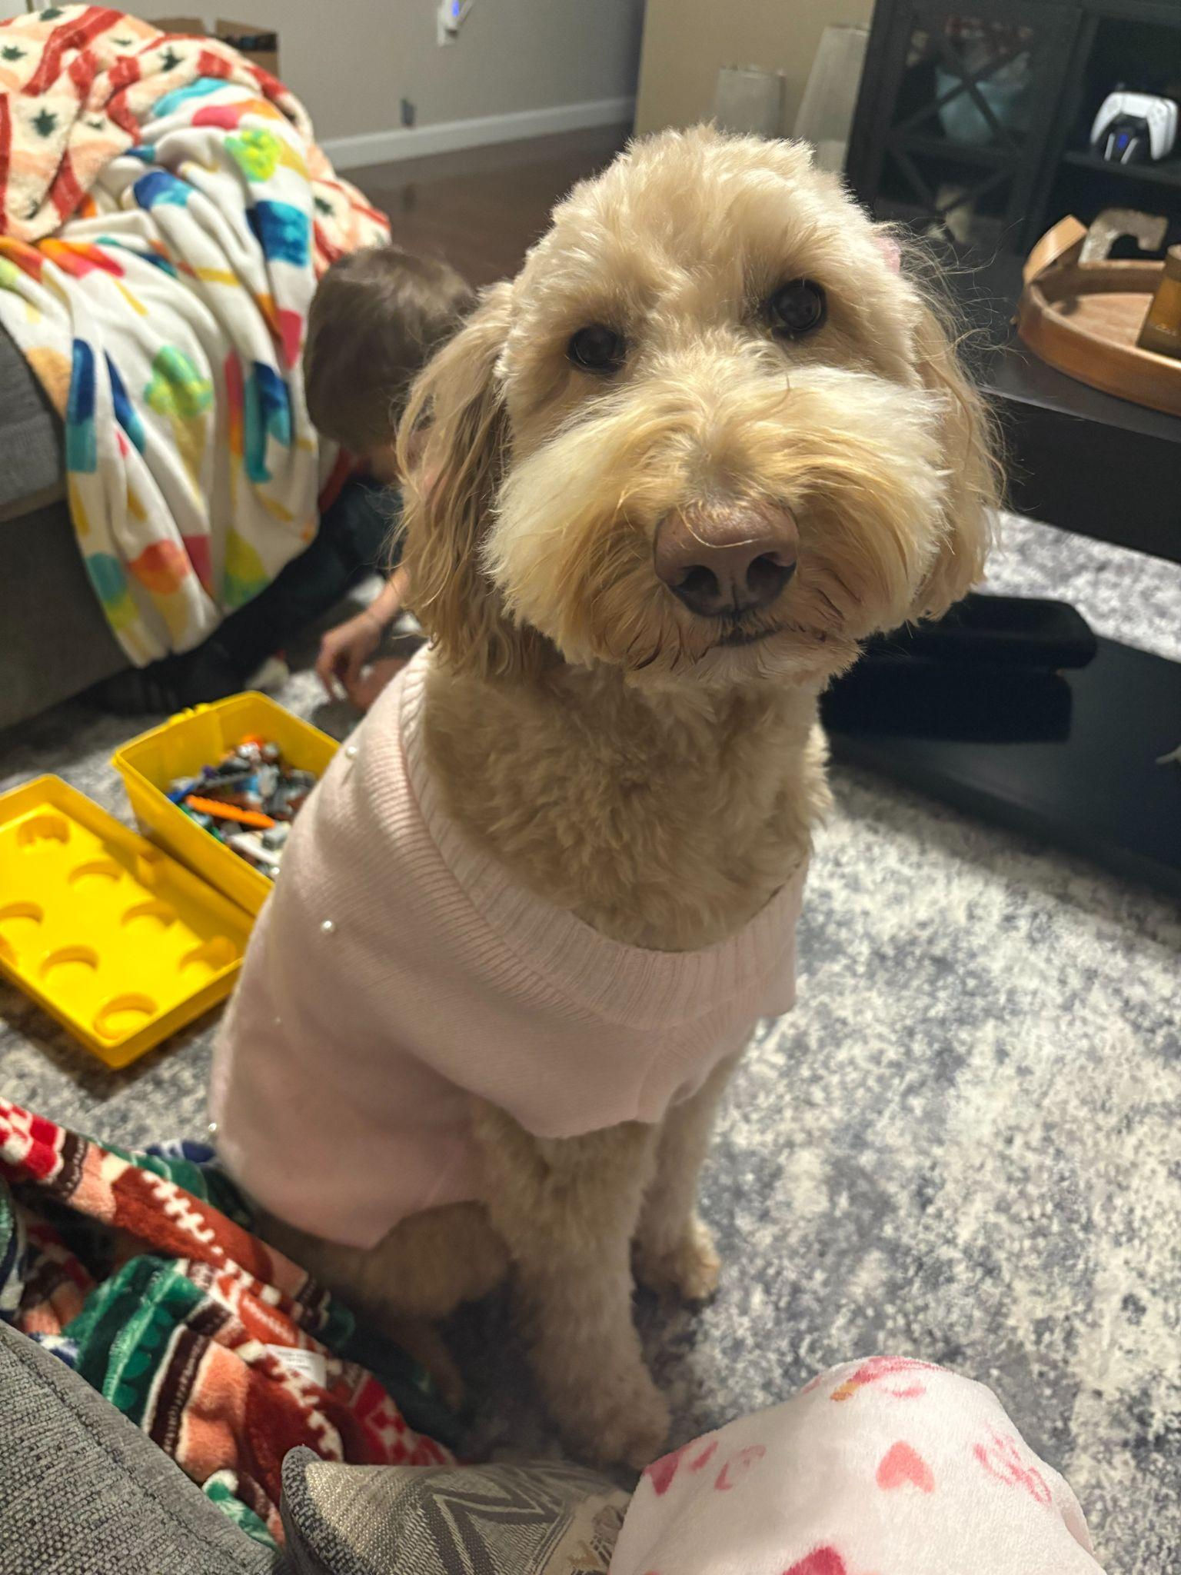
Public Relations: Ava
Year: Junior
Major: Integrative Neuroscience
PCE: Cardiology MA & ER PCT
What PPAS has given me:
  Guidance & Support
  Friends with similar goals
Extracurriculars:
  PPAS!
  NYS Mentoring Program (Public Relations Chair & Mentor)
  Shadowing (Cardiology, Neurosurgery, OBGYN,)
  Volunteering
    Broome County Humane Society
    Food Pantry & Homeless Shelter in Rochester
  Tutoring (middle & high school math)
Fun Fact: My favorite fruit is cantaloupe!

Slide 18
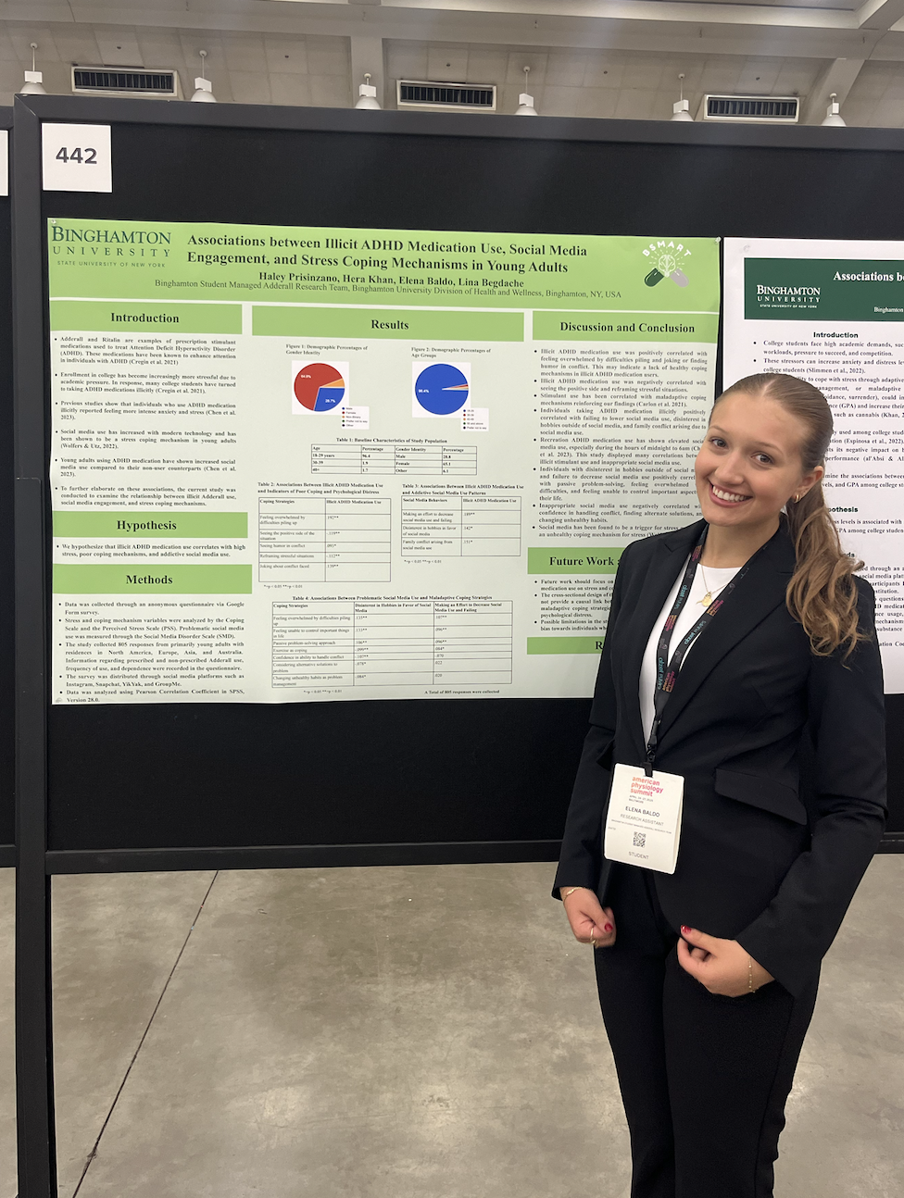
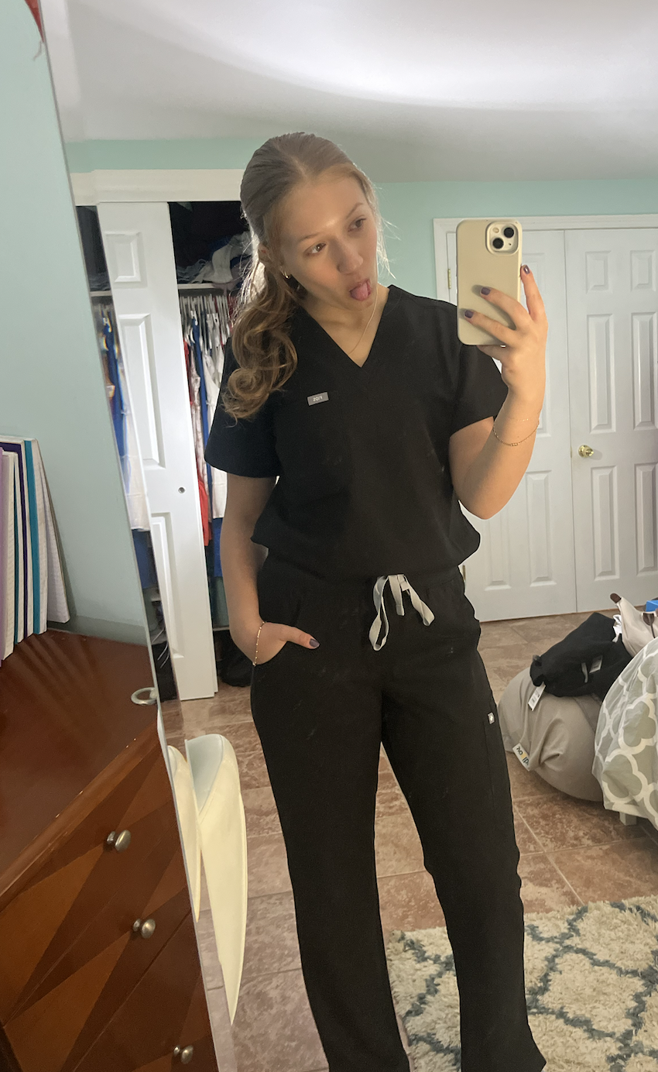
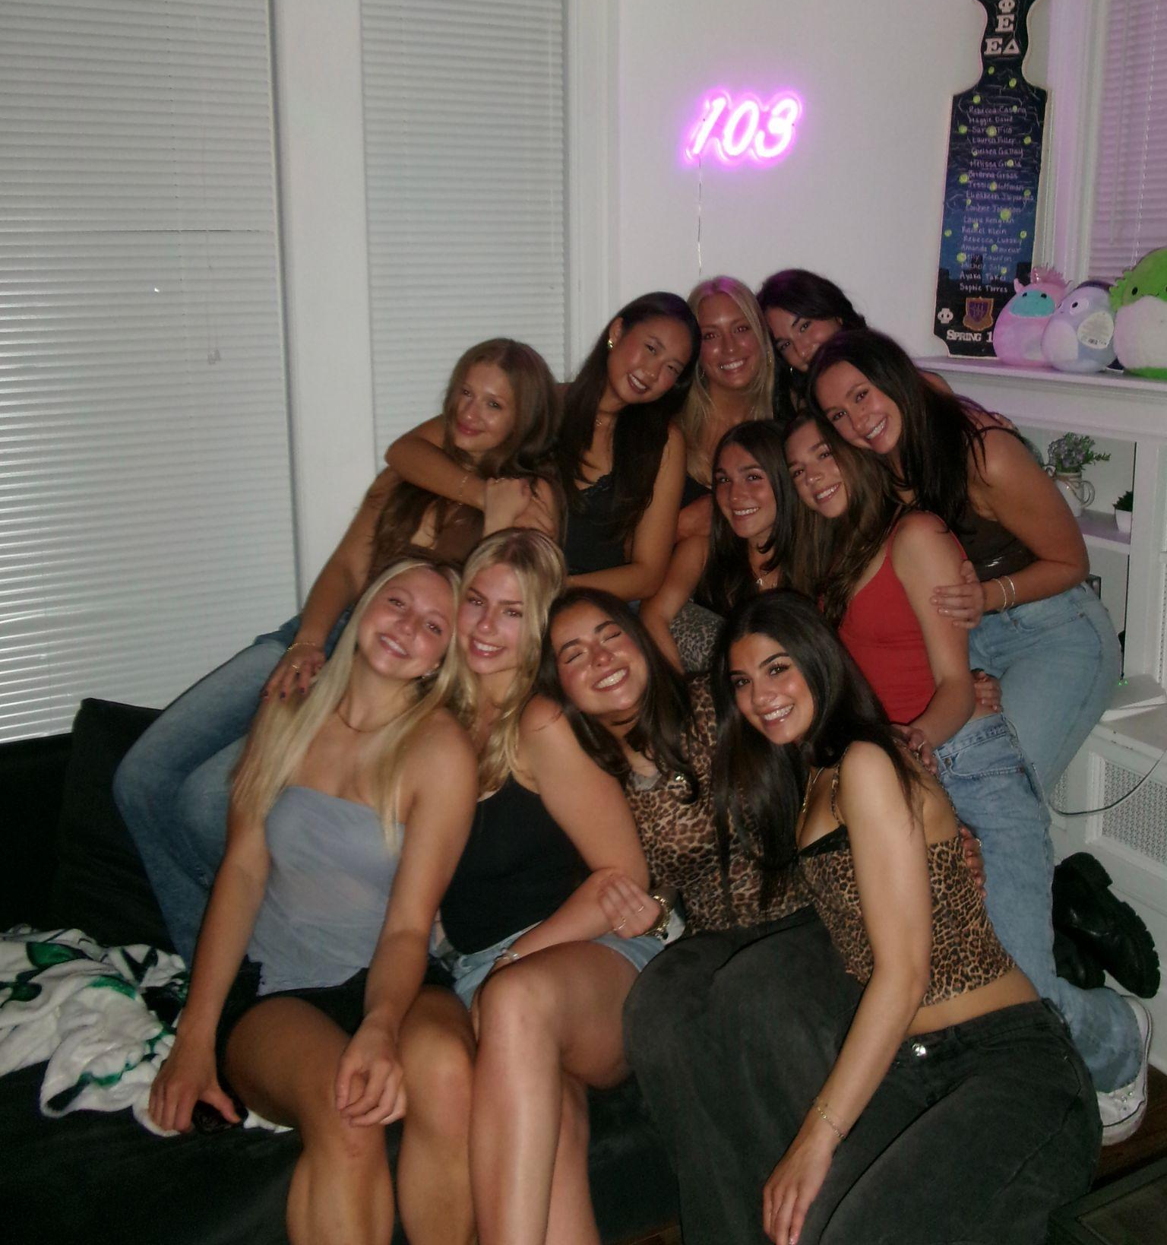
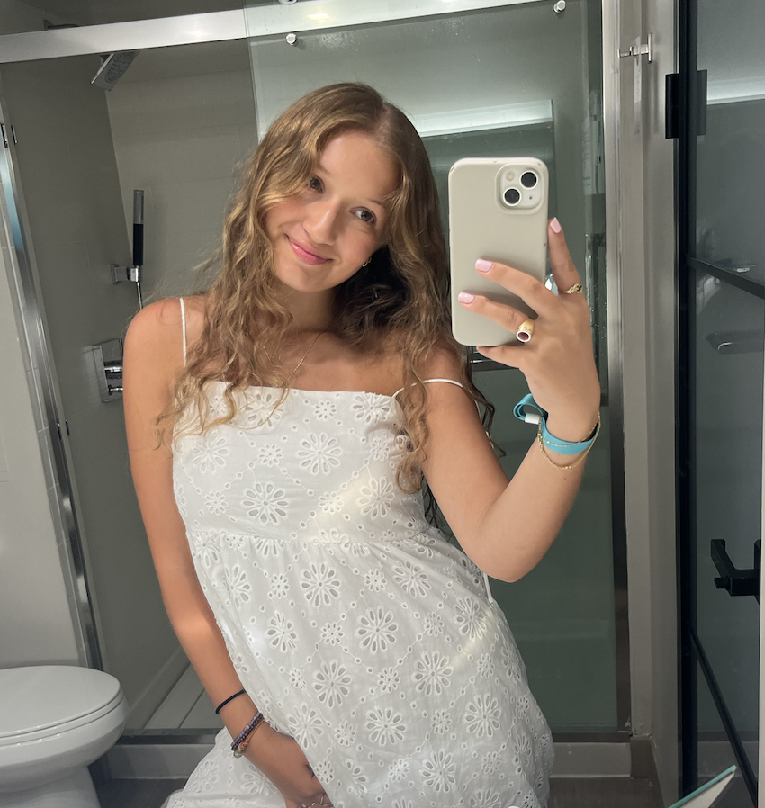
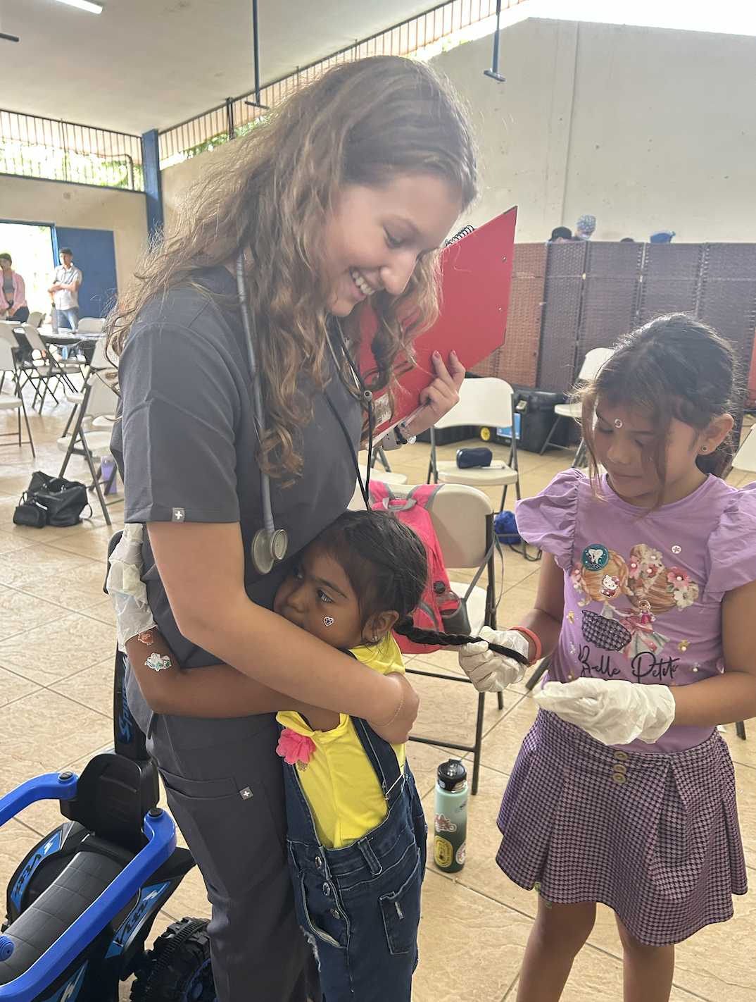
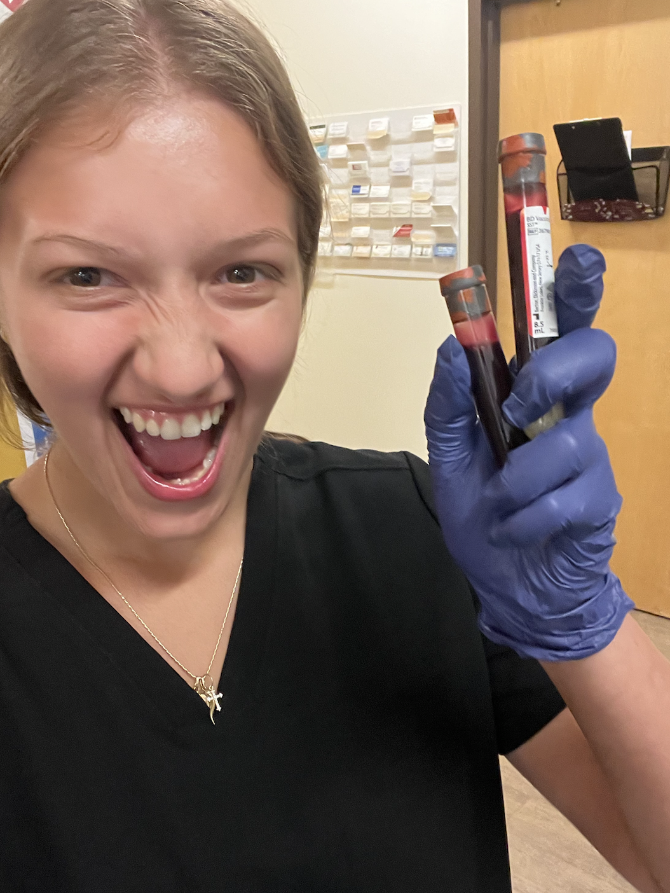
Secretary: Ellie
Year: Senior
Major: Integrative Neuroscience
Minor: HWS
PCE: Urgent Care MA + PCA in Home Health
What PPAS has given me:
  Network of driven, knowledgeable Pre-PA besties to help navigate everything PA!
Extracurriculars:
  This!
  BSMART Lead Researcher
  UTS Anatomy & (past) Gen Chem Tutor
  Mindset Mentors
  TA Experience for Gen Chem, Orgo, & Stress Management
  DPhiE Philanthropy Chair
  Math Tutor at Gigi’s Playhouse
  Service Trip in Costa Rica w/ Sara
Fun Fact: I’m a little over 50% on my way to being a certified phlebotomist (started getting my sticks end of July)!!

Slide 19
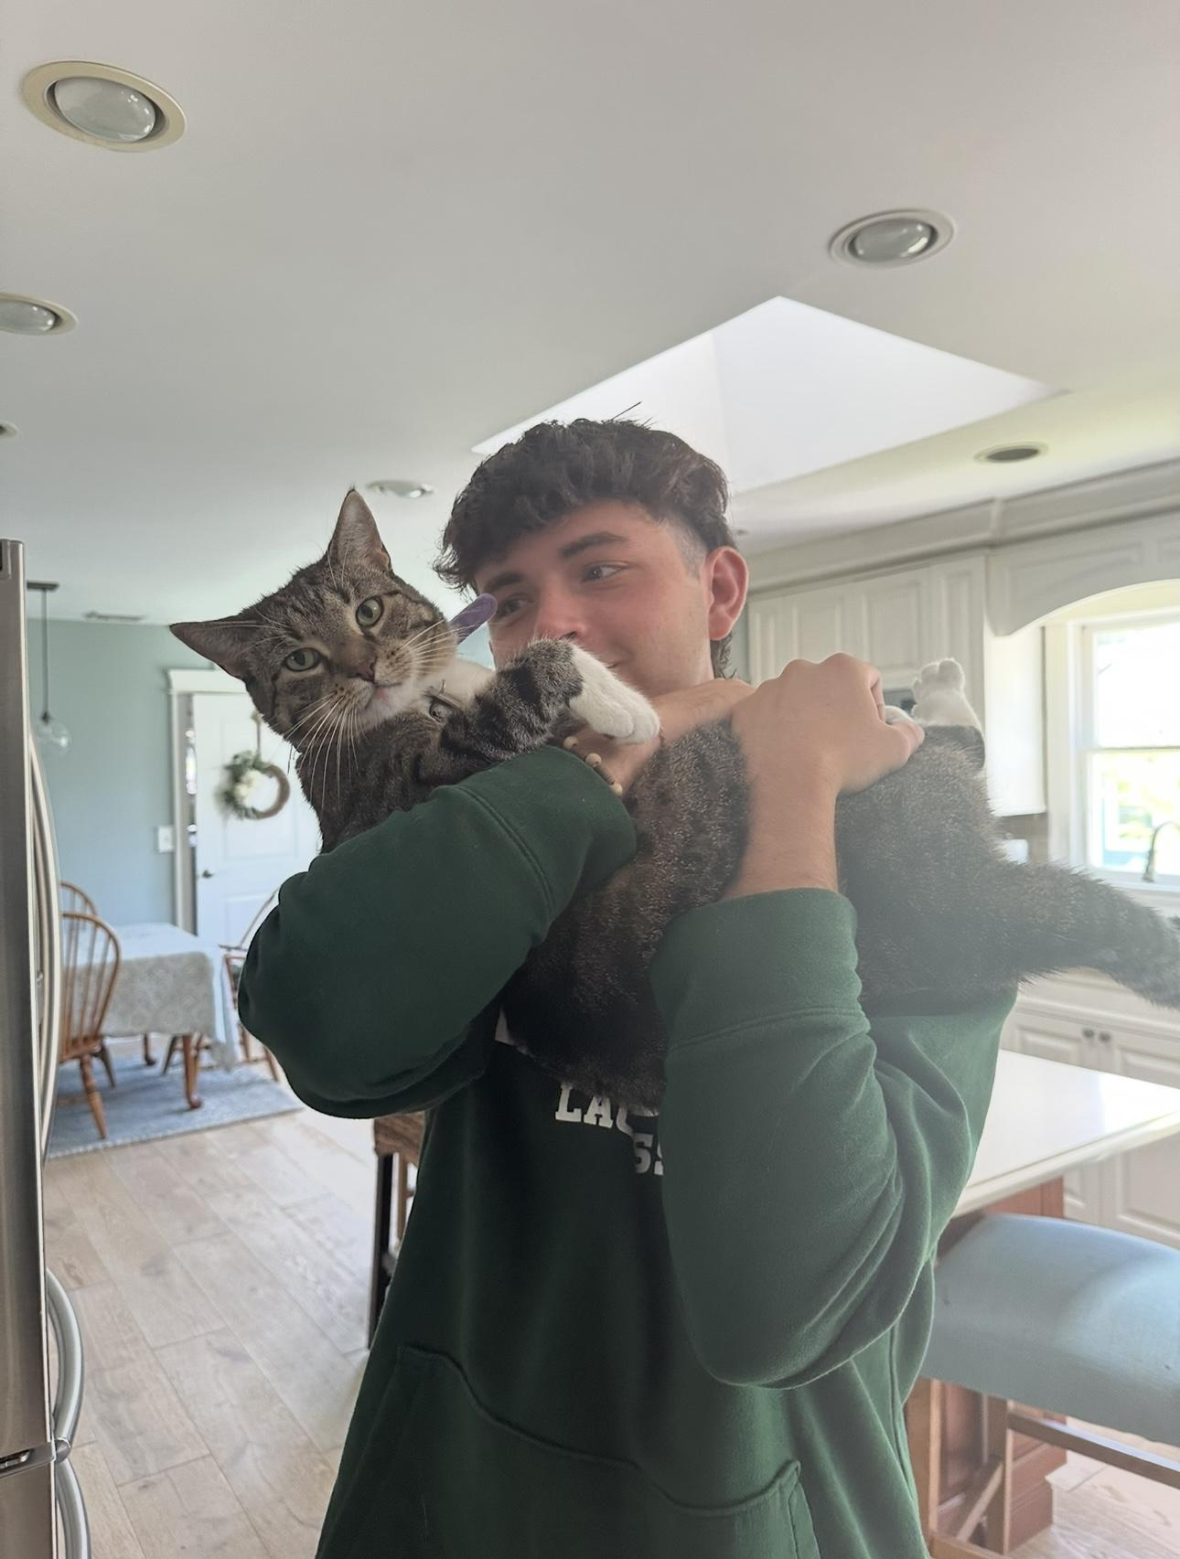
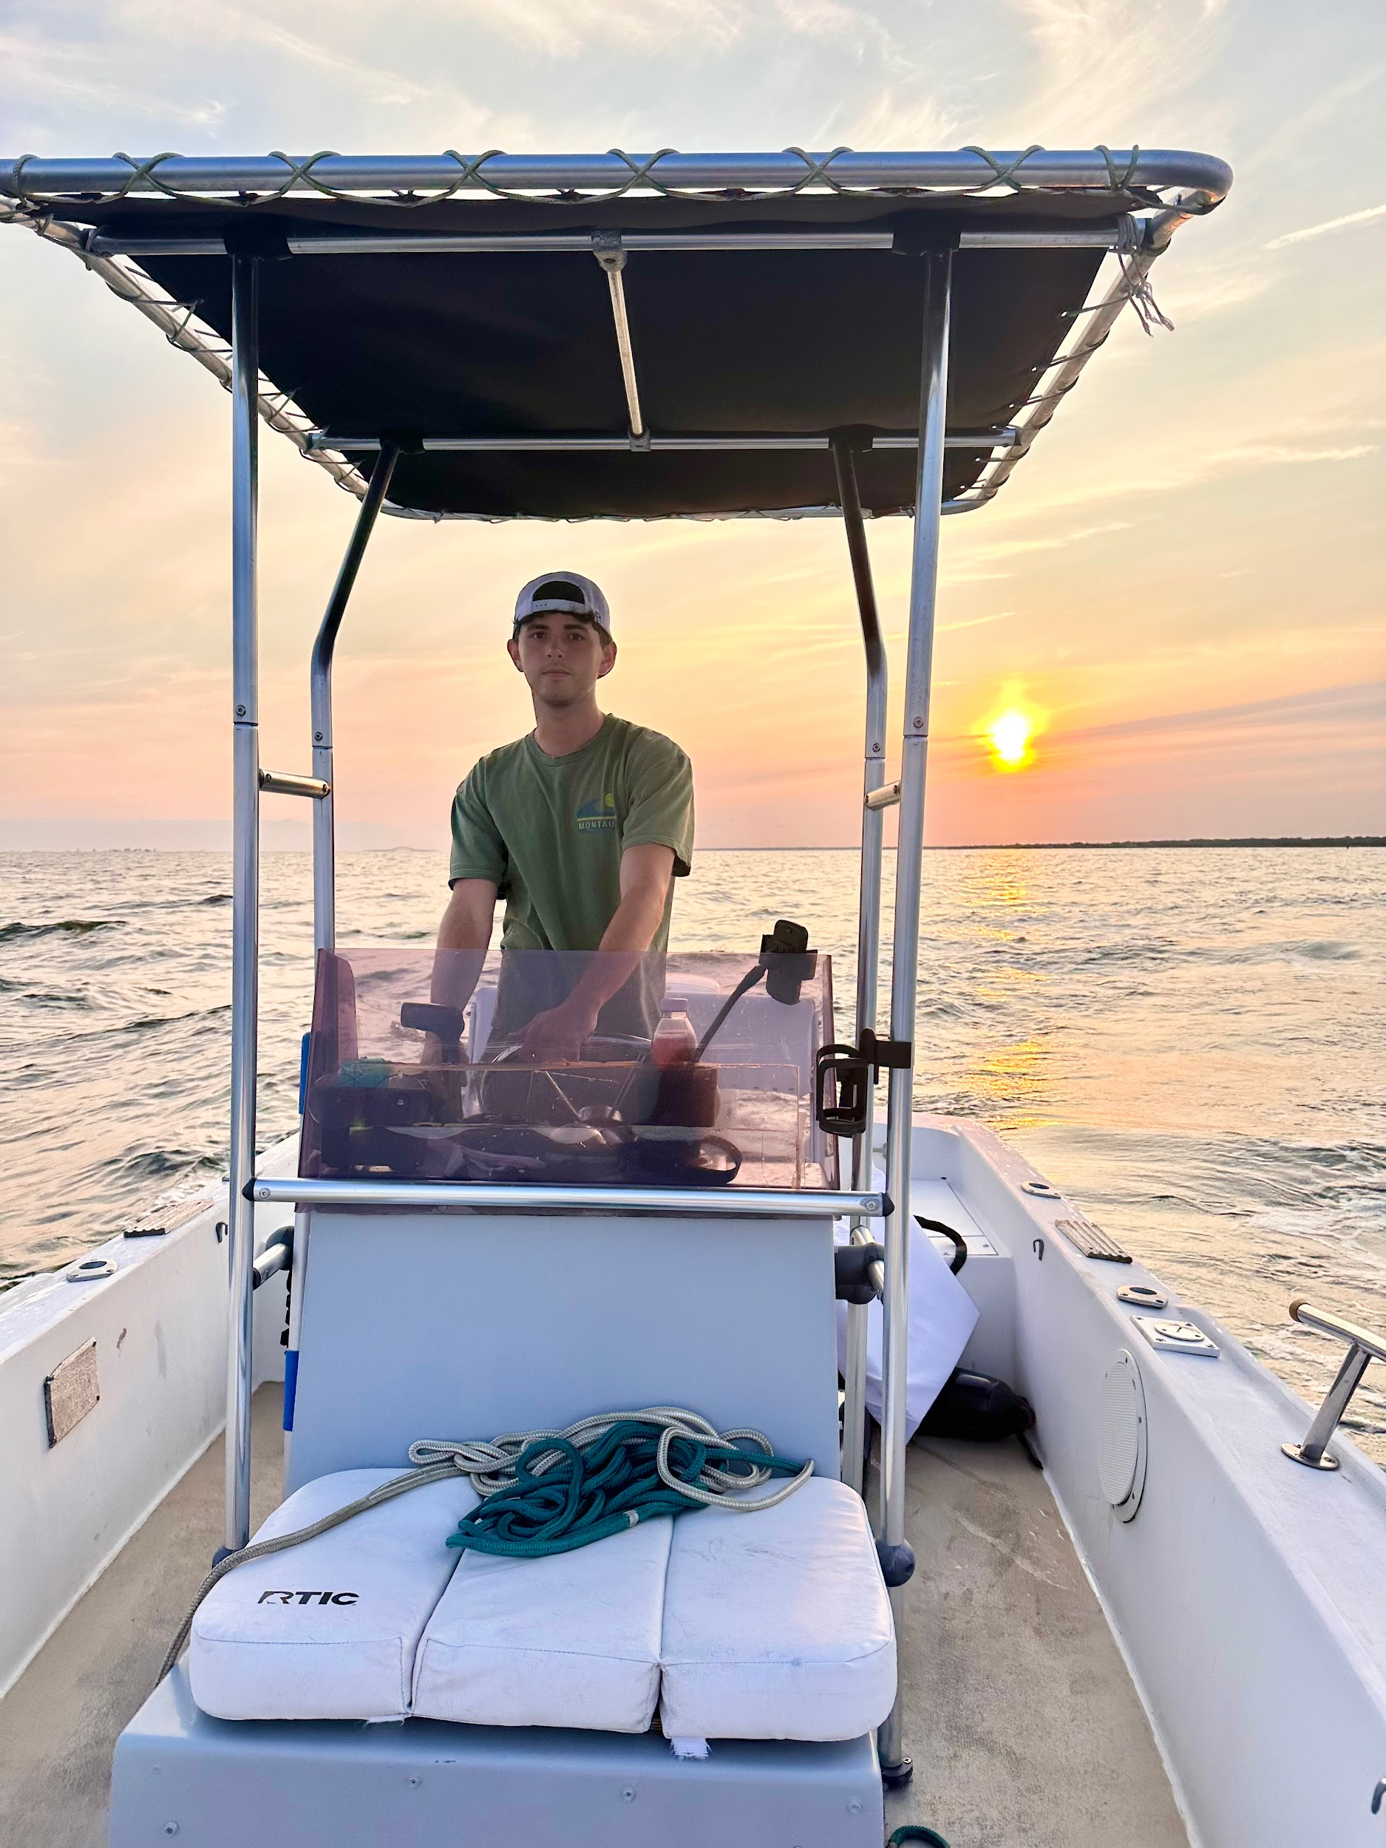
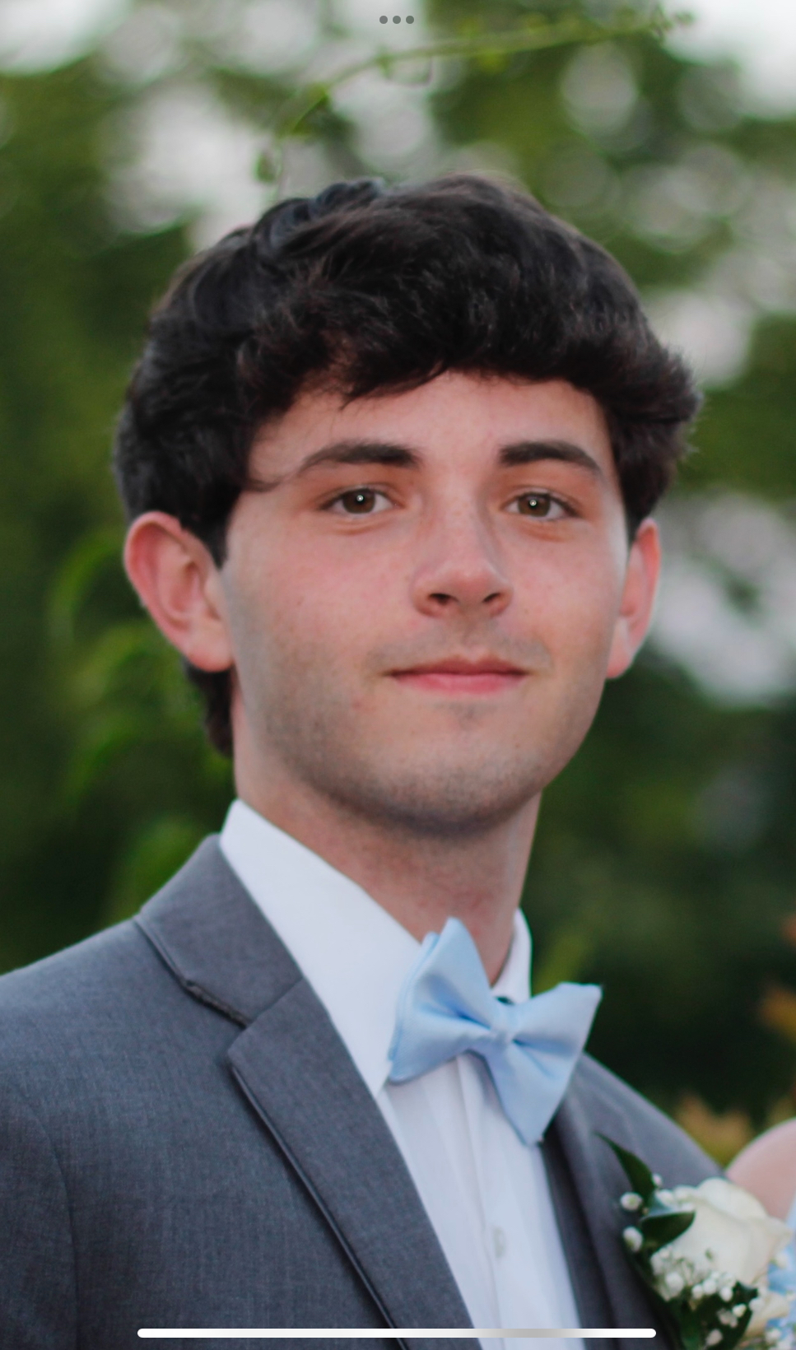
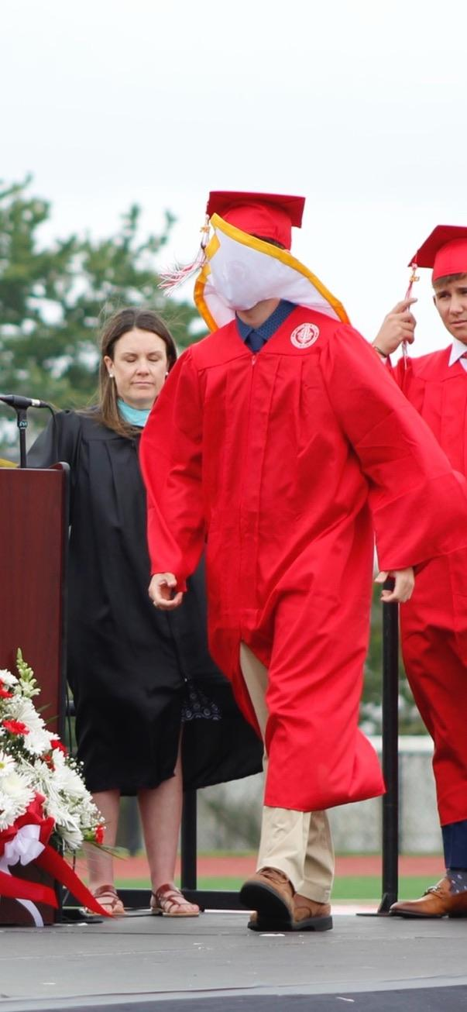
Treasurer: Brian
Year: Junior
Major: Biology
Minor: HWS
PCE: CNA
What PPAS has given me:
The sense of community and shared purpose in working towards becoming a PA
Extracurriculars:
PPAS
Waiter/food runner
Volunteering: Rotacare Hempstead, Broome County Humane Society,
Shadowing (Family Med, Medical ICU)
Fun Fact: I've sprained my ankle 6 times

Slide 20
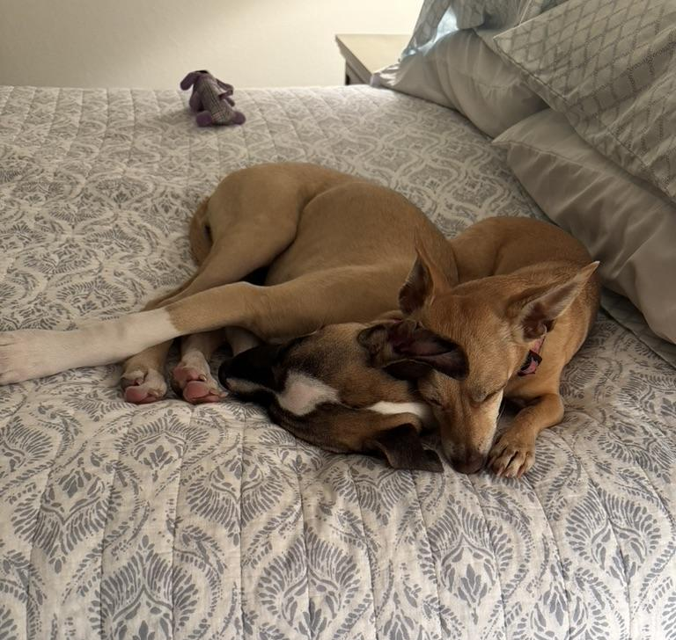

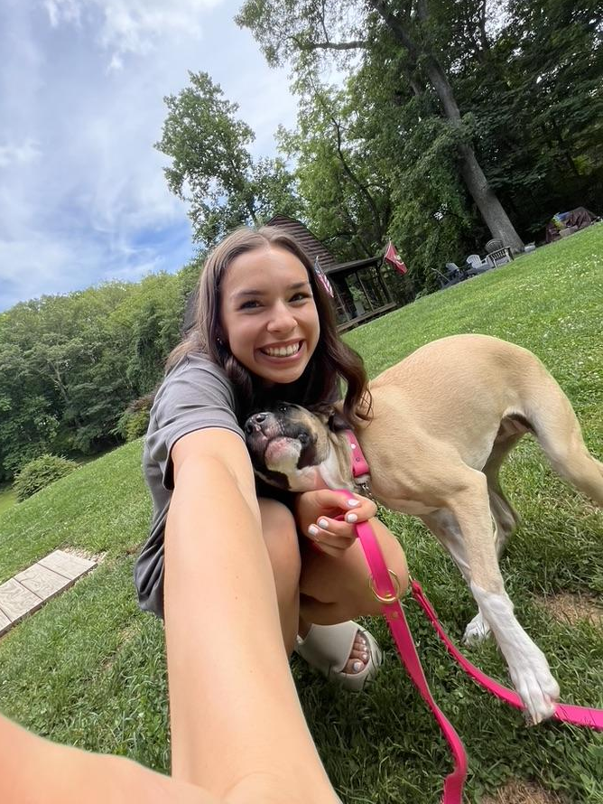
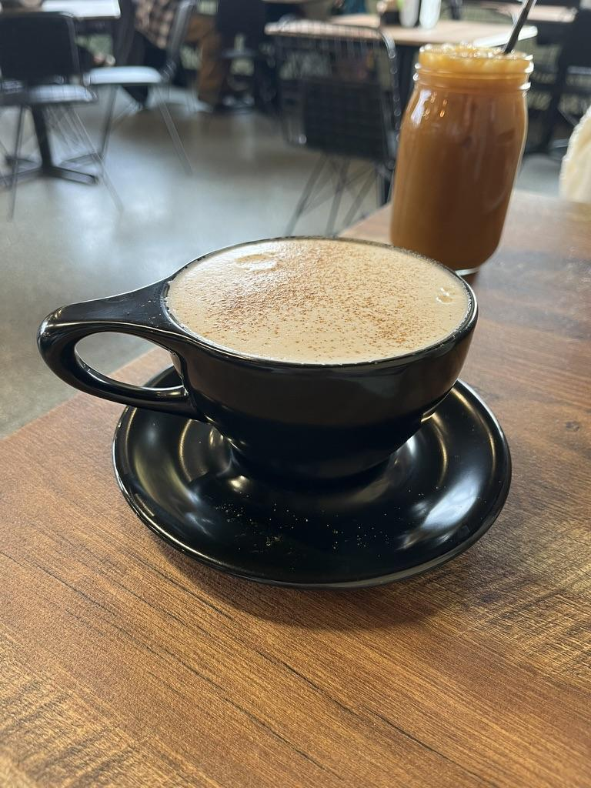
Events Coordinator: Alyssa
Year: Junior
Major: Bio, HWS minor
PCE: CCMA
What PPAS has given me: A network of supportive individuals who strives to see each other succeed!
Extracurriculars: PPAS, General Chemistry TA, shadowing (ED, ICU, OR, ortho, radiology, L&D), Broome County Humane Society, sales associate
Fun Fact: I have 3 dogs!

Slide 21

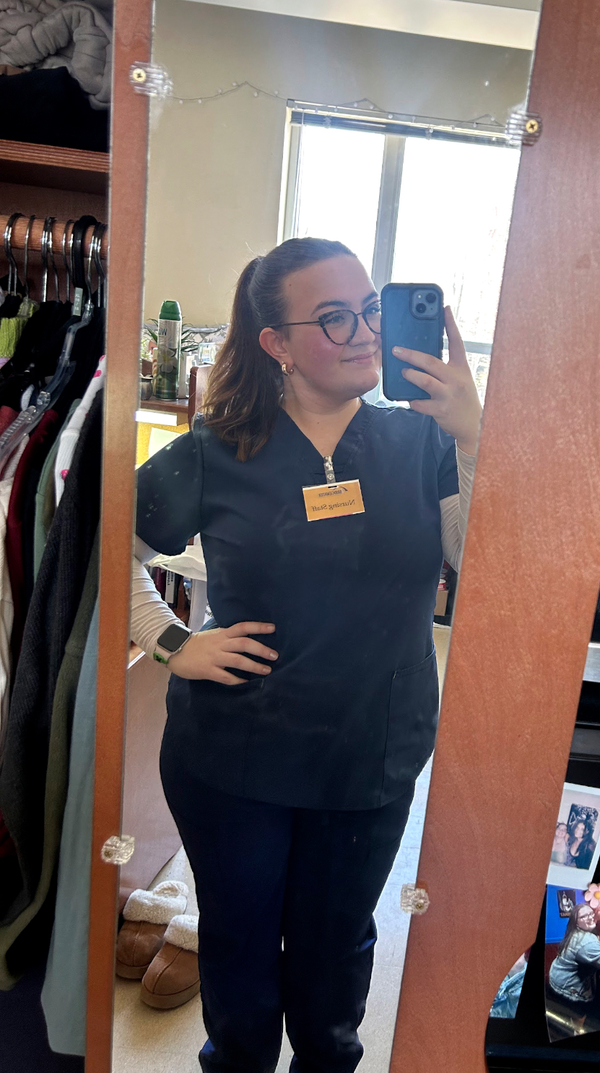
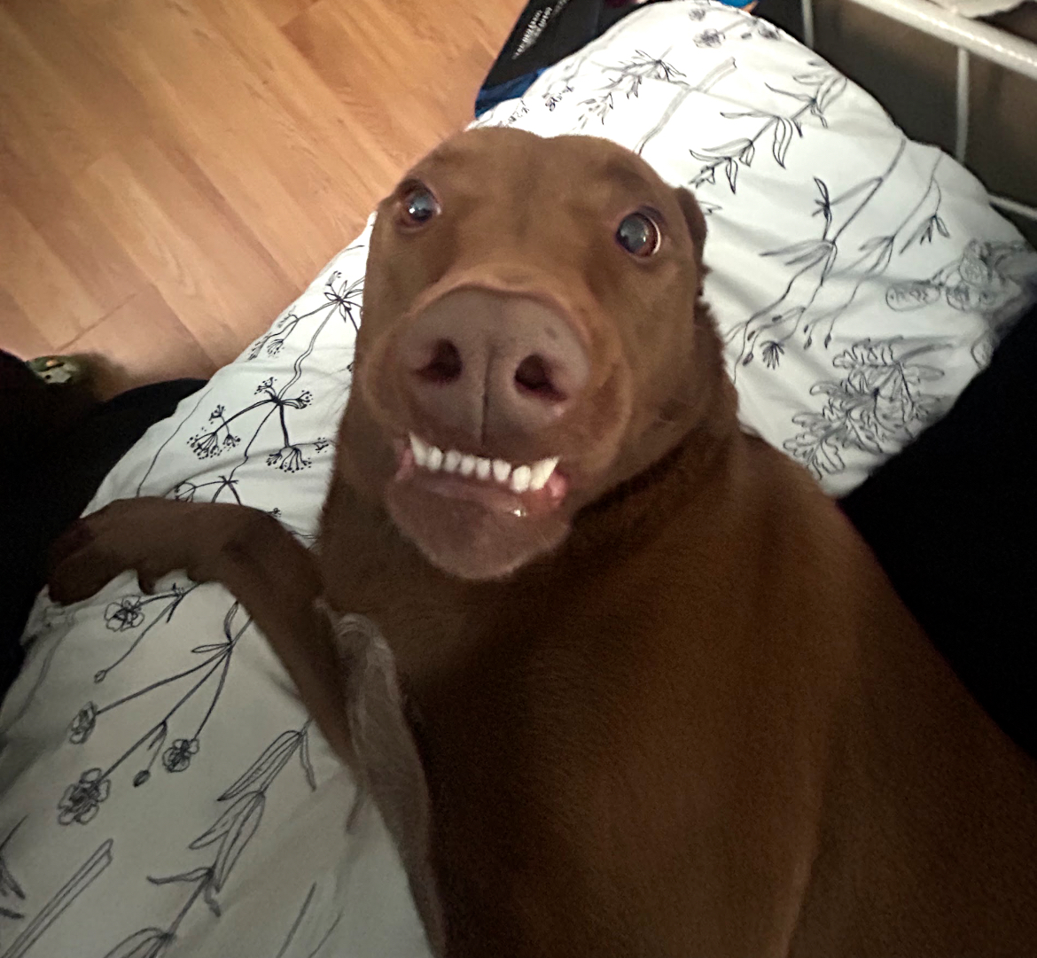

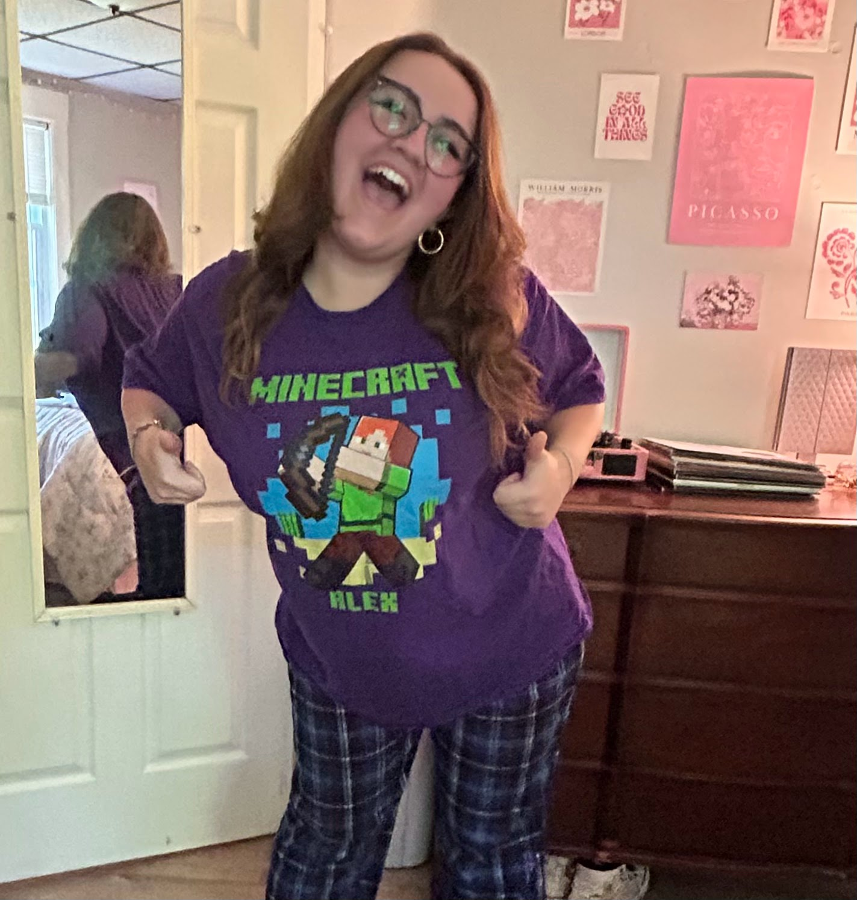
Events Coordinator- Marissa
Year: Junior
Major: Integrative Neuroscience, Forensic Health Minor
PCE: CNA
What PPAS has given me: A circle of friends offering guidance and encouragement to thrive!
Extracurriculars:
  PPSA
  Student Ambassador
  Broome County Humane Society Volunteer
  BU Acapella
  Crisis Text Hotline Volunteer
  Intro Psych TA
  Shadowing (OMM, Gastro, Rheum)
  Olive Garden Waitress 🥖<3
  NuRhoPsi (Neuroscience Honor Society)
Fun Fact: I own over 45 weird/funny t-shirts!

Slide 22
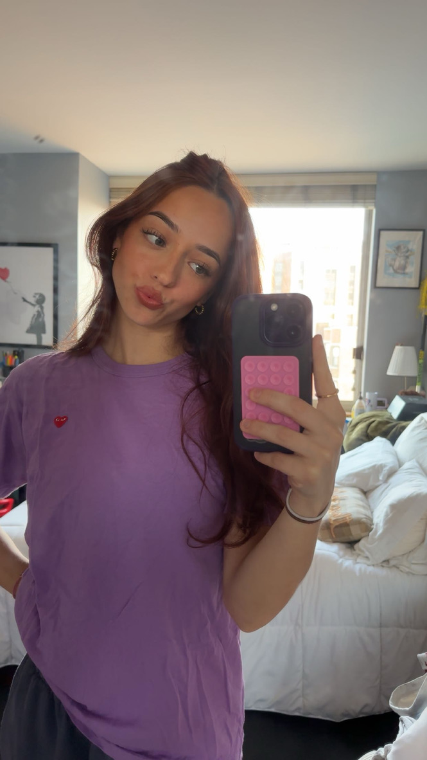
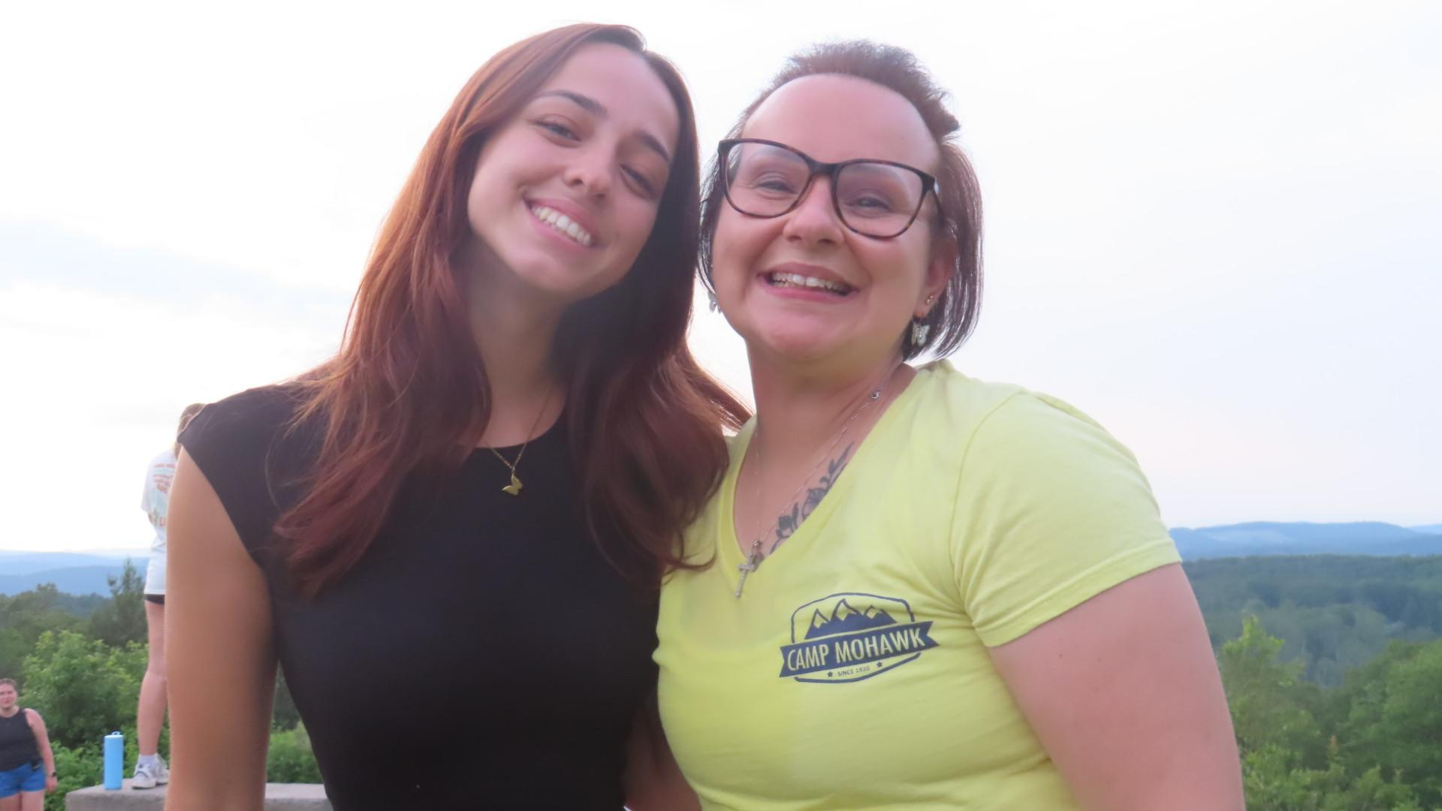
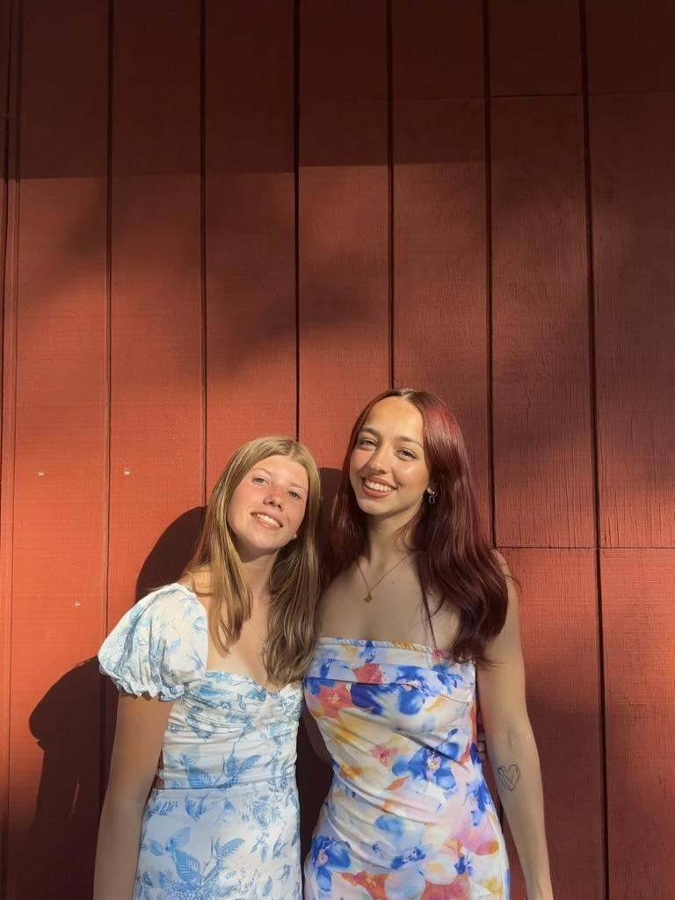
Eboard at Large- Lara
Year: Junior
Major: Biological Sciences
PCE: Nursing Assistant & Phlebotomy trained
What PPAS has given me: A resource to guide my toward my career path in a collaborative community
Extracurriculars: Social Tees, PStat TA, UTees CM, Libros del Mundo Director, member of KKG
Fun Fact: I got a tattoo in Thailand and another in Spain

Slide 23
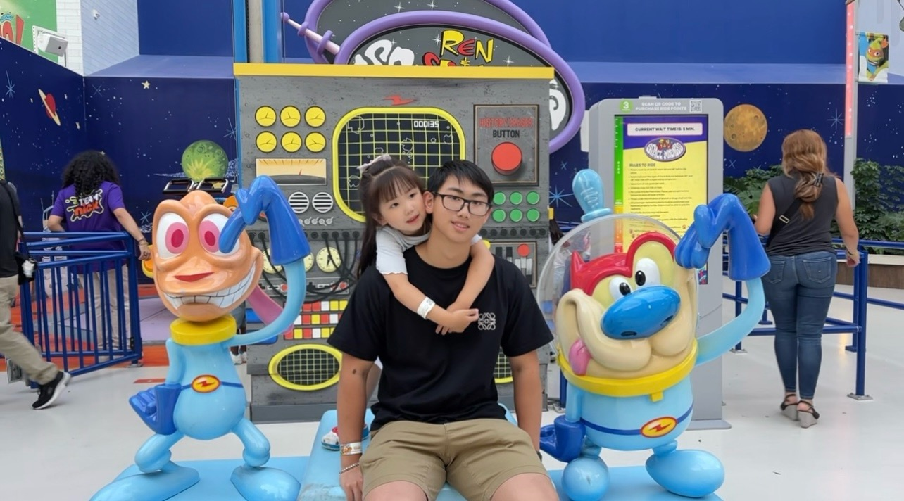
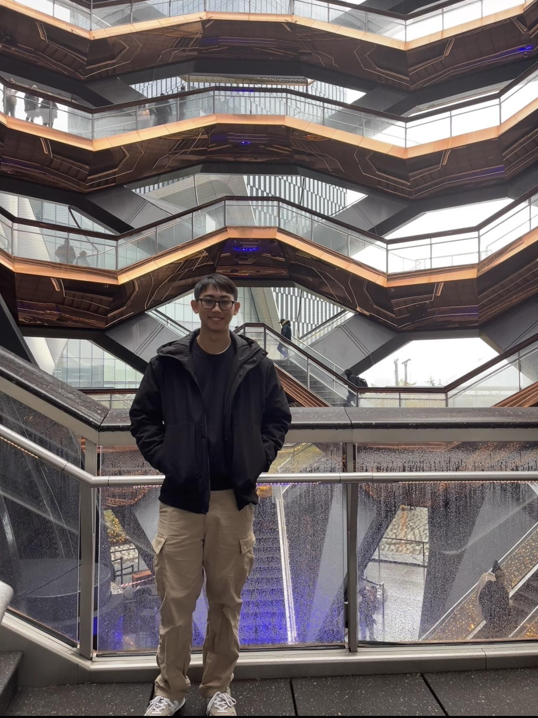
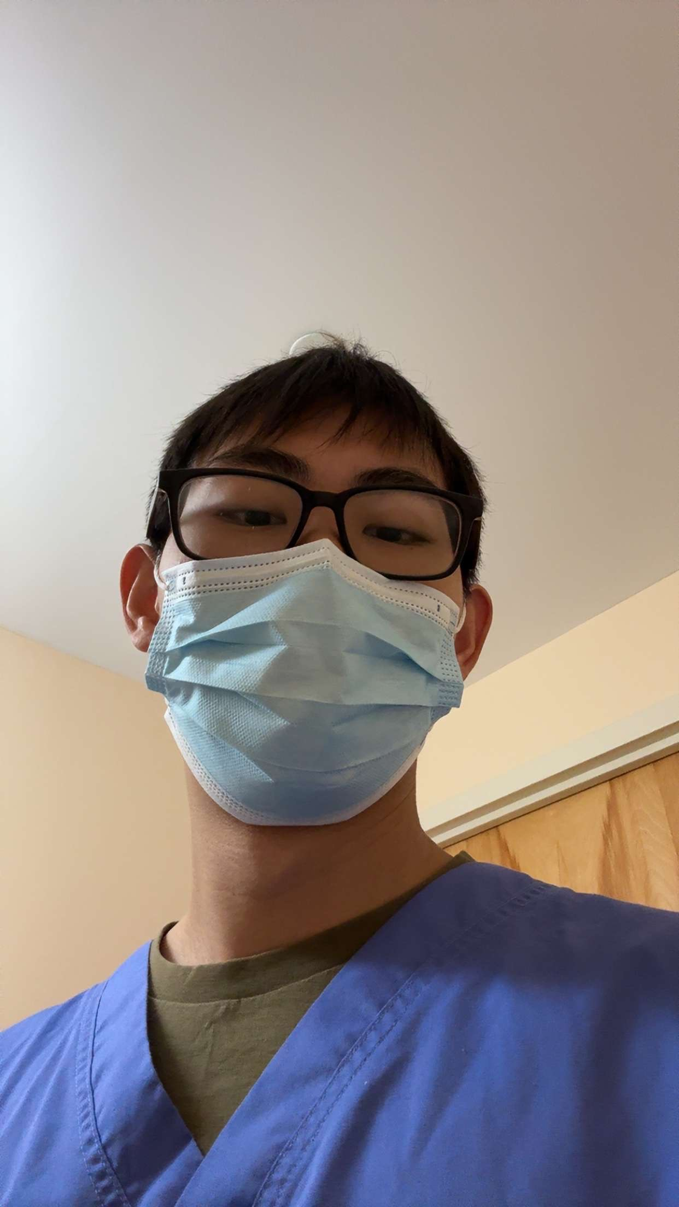
Eboard at Large- Alston
Year: Junior
Major: Integrative Neuroscience
PCE: CNA
What PPAS has given me:
-Lots of guidance and advice to becoming a PA!
Extracurriculars:
-PPAS
-Broome County Humane Society Volunteer
-Research Assistant in the Karkhanis Lab
-Secretary of China Care Club
-Organic Chemistry TA
Fun Fact: My parents own a hibachi restaurant on Long Island!

Slide 24
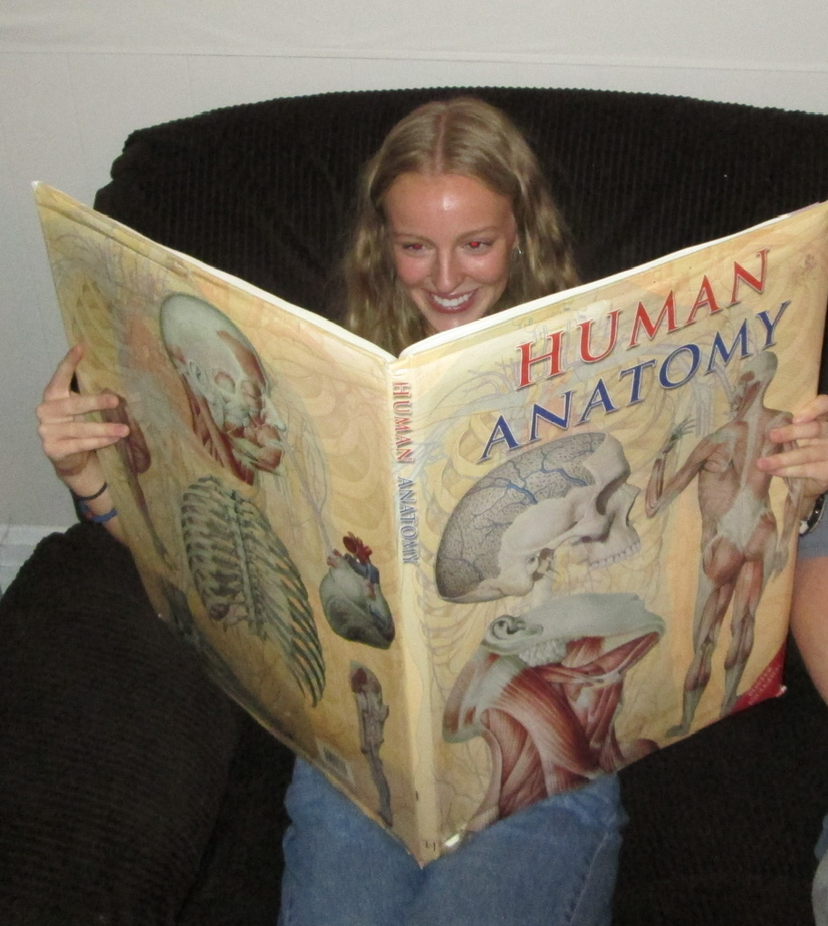
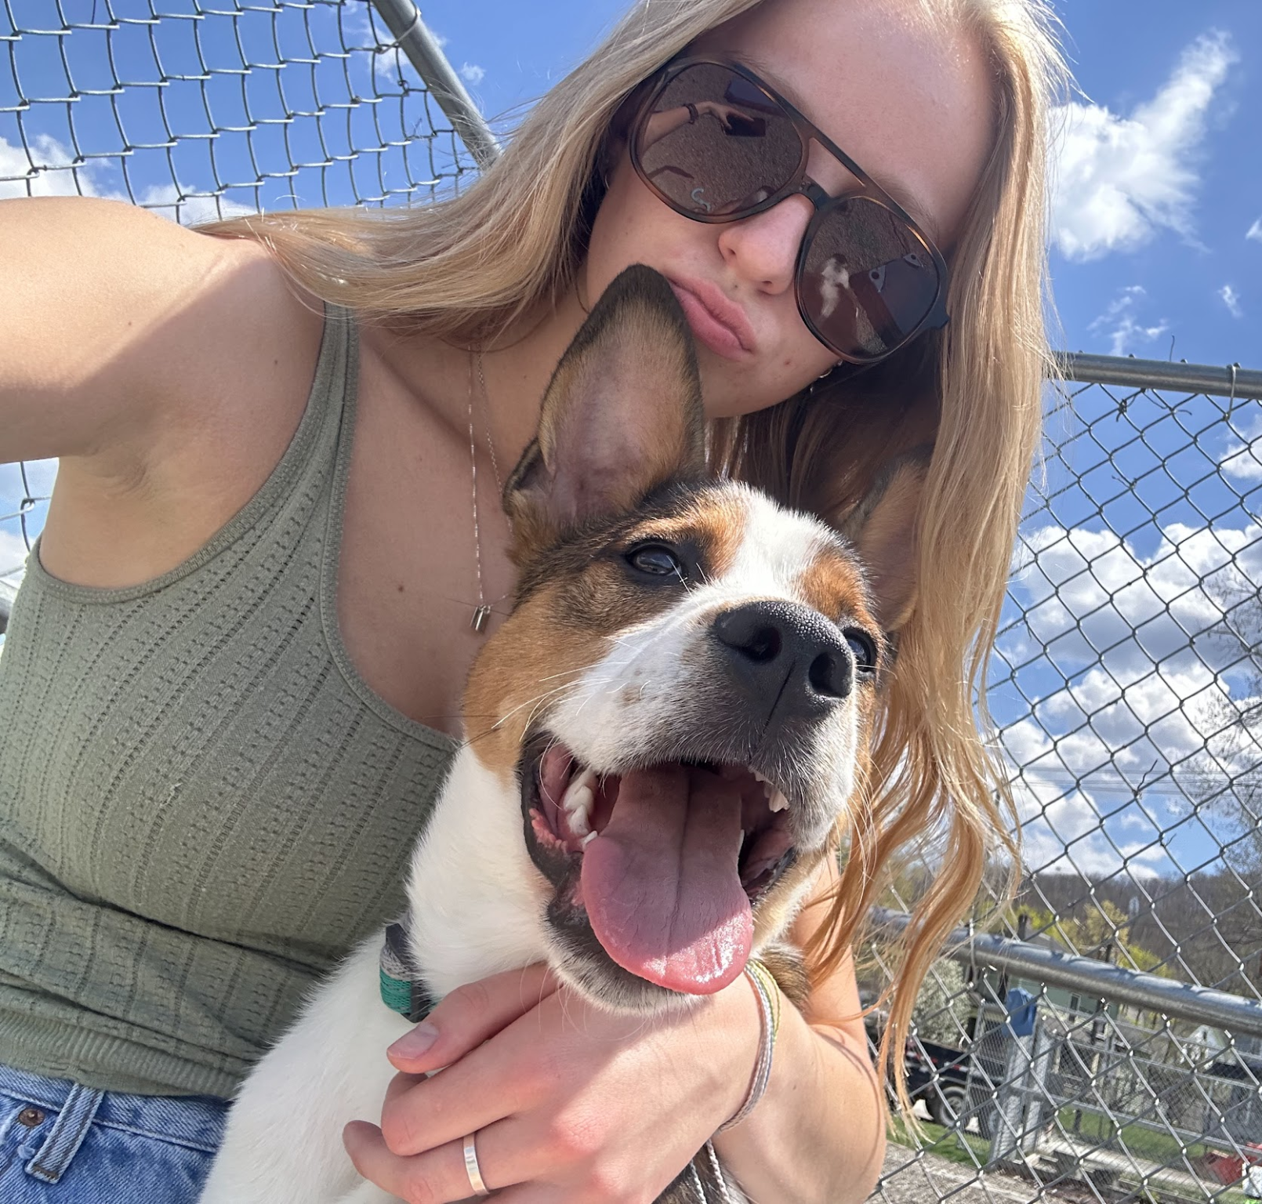
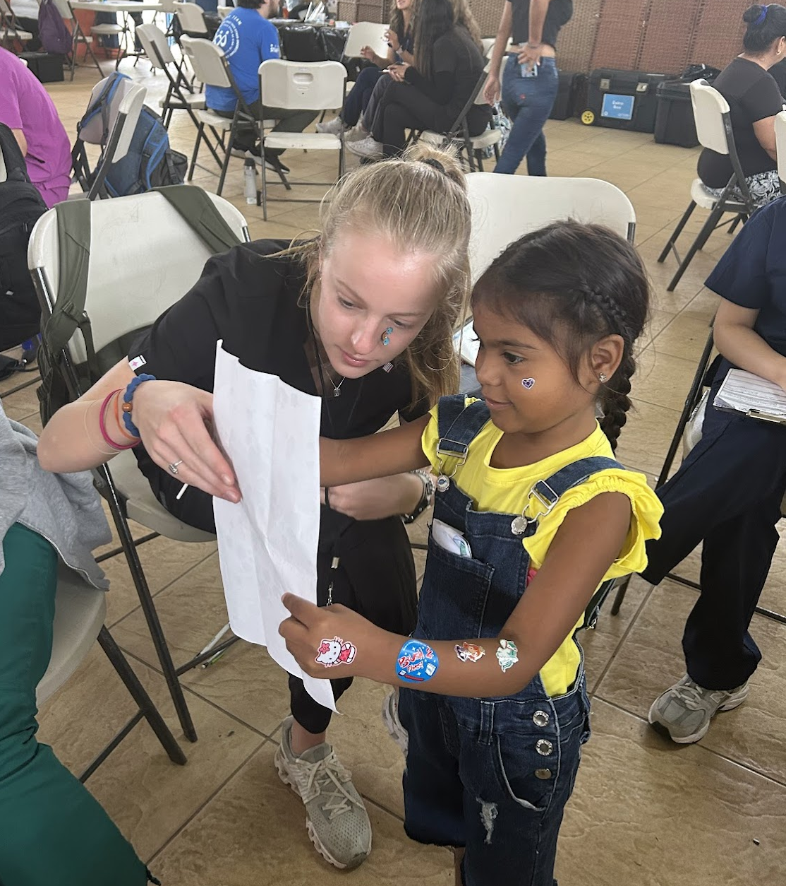
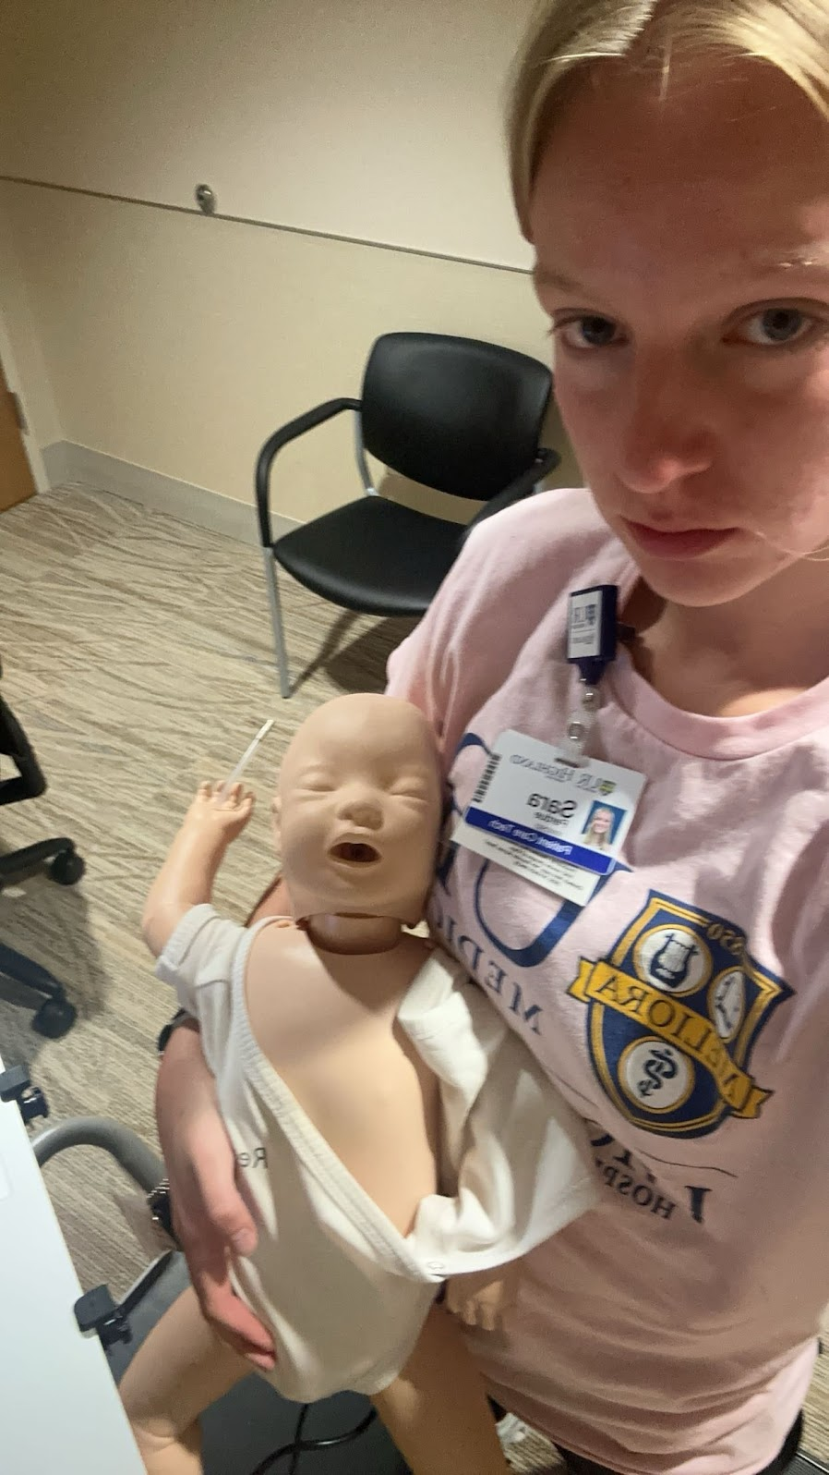
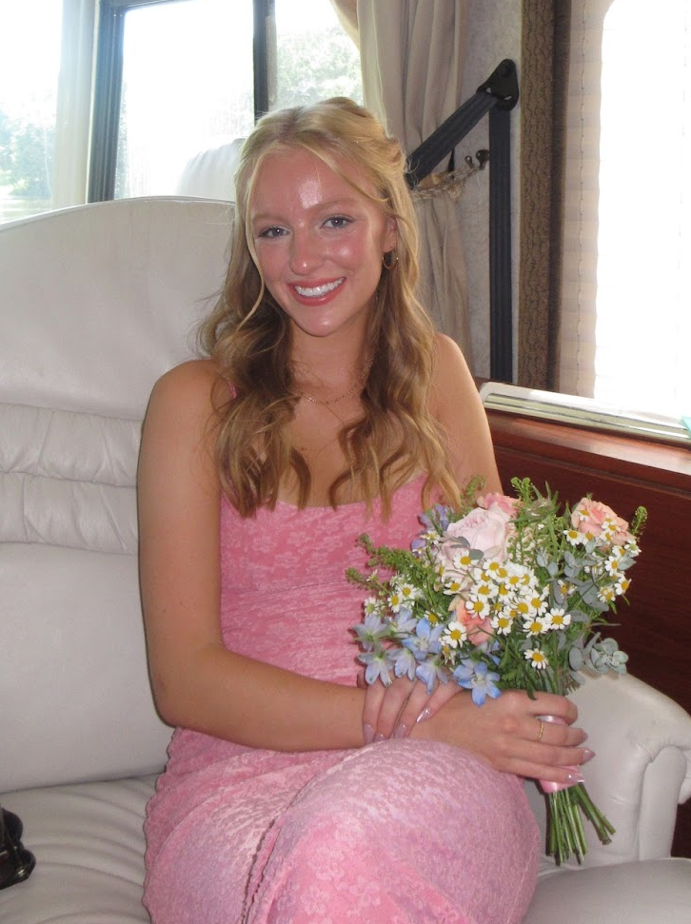
Eboard at Large- Sara
Year: Senior
Major: Integrative Neuroscience
PCE: Companion Observer, PCT
What PPAS has given me: an amazing amount of career and academic guidance!
Extracurriculars:
  PPAS
  Women’s Club Lacrosse
  East Gym Building Manager
  Broome County Humane Society Volunteer
  Boys and Girls Club Mentor
  Gigi’s Playhouse English Tutor
  20:1 Student Assistant
  Service Trip in Costa Rica with Ellie
  Barista/Bartender at home
Fun Fact: I shadowed at a gyno clinic over the summer and loved it!

Slide 25
How can PPAS Help YOU?
Advising - academic or not!
Knowledge about the profession
HCE/PCE opportunities
Volunteering opportunities
Shadowing connections
Study groups and materials
Friends
Meet with PA schools via Zoom
Office hours with Eboard
Better understanding of PA school timelines
Application and Personal Statement help
Lots more!

Slide 26
How this Semester will run:
In person biweekly meetings!
  Tuesdays from 8-9 PM
    Be on the lookout for our instagram posts and emails!
  New topics each week!
    PCE vs HCE, differences between PA/MD/NP, scheduling, pre reqs, resume boosters, and more!
Biweekly Office Hours
  Held on weeks we don’t have in person meetings
  Meet with Eboard members on zoom to ask any questions you have as you begin/continue your Pre-PA journey!
Zoom Panel with PA-Cs!
Zooms with Graduate PA Program Admissions!
In Person Weekly Volunteering with Broome County Humane Society!

Slide 27

Thank you for Coming!! :)
Upcoming Events
  We have a collab with BAH, 9/2 from 8-9PM in UU 111
  Next general body meeting is 9/9 from 8-9pm in UU 202
  First Office Hour will be 9/16 from 8-9PM on Google Meet
Follow us on instagram for updates @bingppas
Info about volunteering at Broome County Humane Society coming soon!
Join our Groupme!
Attendance!

Slide 28

BSMART SURVEY!!

