Slide 1
General Interest Meeting #2

Slide 2
Agenda
Mission
Introductions
Background
Club Offerings
2019-2020 Schedule
Questions
2

Slide 3
Mission
Our mission is to provide education, professional development, experiences, opportunities and connections to Binghamton University students interested in the sports management field and serve and assist companies local to the Binghamton community while allowing students to gain real world work experience.
Mission | Introductions | Background | Club Offerings | Schedule| Questions
3

Slide 4
Introductions
Kieran Rose
President
Julian Alegre
Vice President of Case Competition
Frank Porcasi
Vice President of Engagement
Matthew Iberger
Head of Marketing and Web Design
Kevin Youh
Project Lead for Engagement
Emily Kogan
Head of Marketing and Web Design
Saad Salman
Case Competition and Meeting Planner
Chris Schwarm
Treasurer of SMG
Fabian Hoh
Head of
Fundraising
Lexie Tillman
Senior Advisor of SMG
Mission | Introductions | Background | Club Offerings | Schedule| Questions
2
4

Slide 5
Why We Started The Club
Currently does not have a sports management major or club until now
A lot of interest in the field, but limited opportunities
Difficult to compete for jobs due to lack of experience
Mission | Introductions | Background | Club Offerings | Schedule| Questions
5

Slide 6
Background
SA/SOM Chartered
Organization kicks off
E-Board Formed
Organization Founded
February 2019
May 2019
April 2019
Present
Mission | Introductions | Background | Club Offerings | Schedule| Questions
6

Slide 7
Club Offerings
Sports Professionals Speaker Series
Sport Industry Overviews
Professional Development Workshops
Community Involvement
Sports Marketing Internship at Binghamton University
March Madness Flash Case Competition
Fantasy Leagues and Intramurals
Mission | Introductions | Background | Club Offerings | Schedule| Questions
7

Slide 8
Speaker Series
Eleven sports professionals each with their own story and experience to share
Opportunity to ask these professionals about anything – they want to help
Will be a mix of in-person and Skype
Mission | Introductions | Background | Club Offerings | Schedule| Questions
8

Slide 9
Sport Industry Overviews
Broad overview of a specific industry within sports (Marketing, Sales, etc.)
Provides background information about opportunities within those jobs
Will help create a better understanding of your career path
Mission | Introductions | Background | Club Offerings | Schedule| Questions
9

Slide 10
Professional Development
Cover Letter & Interview Preparation
Assist members with developing their resumes for job applications
Instruct members on how to best interview for jobs in the sports management field
Help grow your professional network by learning valuable communication skills
Resume Workshop
Networking Workshop
Mission | Introductions | Background | Club Offerings | Schedule| Questions
10

Slide 11
Community Involvement
Mission | Introductions | Background | Club Offerings | Schedule| Questions
11

Slide 12
Sports Marketing Internship
Hands on marketing experience with the University Athletic Department
Exposed to networking opportunities with Binghamton alumni and professionals
This opportunity will be further introduced in December
Mission | Introductions | Background | Club Offerings | Schedule| Questions
12

Slide 13
Flash Case Competition
5 rounds (each round will take around an hour without access to a computer or phone)
Teams will learn to work on problem solving skills and presenting skills. prize TBD
Teams of two will go head to head dealing with sports management related cases
Teams will present the same case and the best team will move on to the next round
Mission | Introductions | Background | Club Offerings | Schedule| Questions
13

Slide 14
Additional Opportunities
Fantasy Leagues
Intramurals
- Talk to Matt after the GIM if you’re interested in participating
- If this interests you, tell us after the GIM and we will organize them
Mission | Introductions | Background | Club Offerings | Schedule| Questions
14

Slide 15
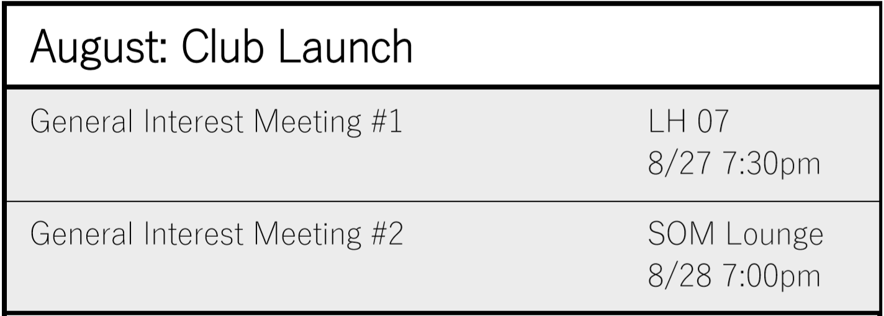
2019 Schedule
Maybe a 3rd?
Mission | Introductions | Background | Club Offerings | Schedule| Questions
15
12

Slide 16
2019 Schedule
Mission | Introductions | Background | Club Offerings | Schedule| Questions
16
12

Slide 17
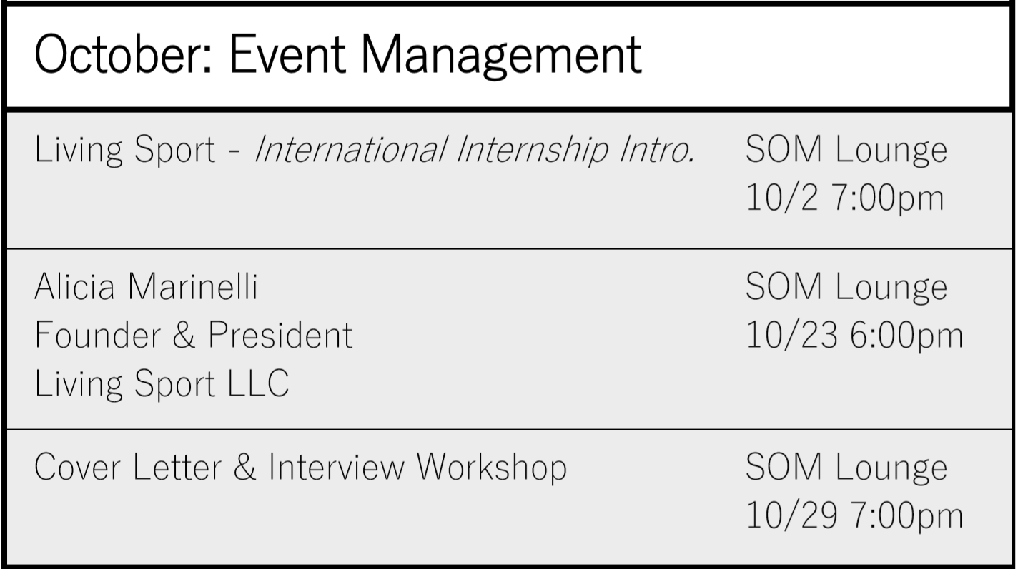
2019 Schedule
Mission | Introductions | Background | Club Offerings | Schedule| Questions
17

Slide 18
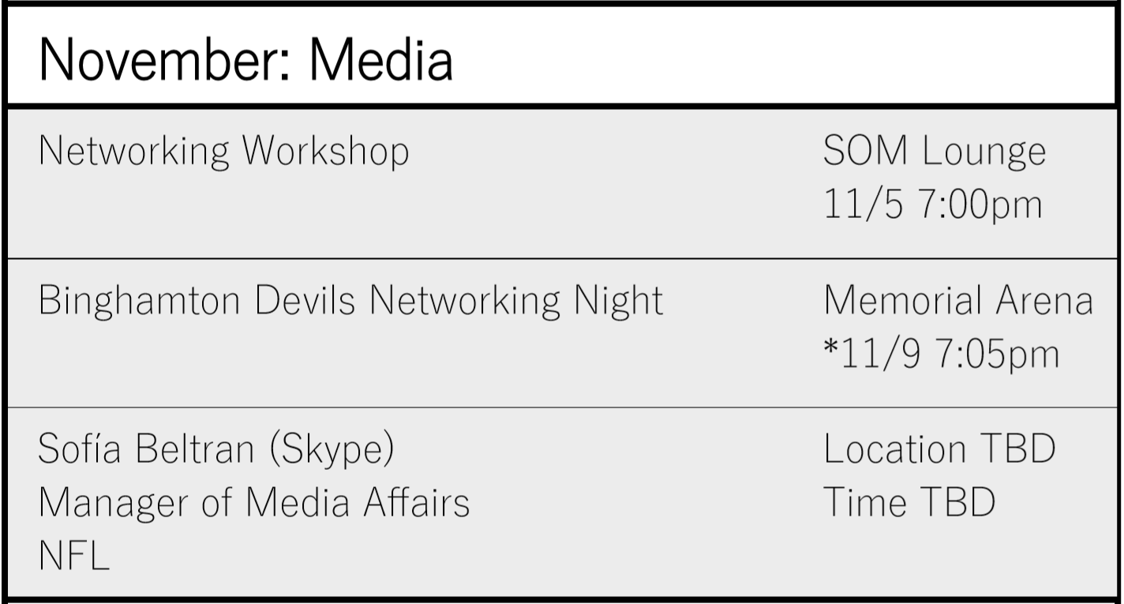
2019 Schedule
Mission | Introductions | Background | Club Offerings | Schedule| Questions
18

Slide 19
2020 Schedule
Mission | Introductions | Background | Club Offerings | Schedule| Questions
19

Slide 20
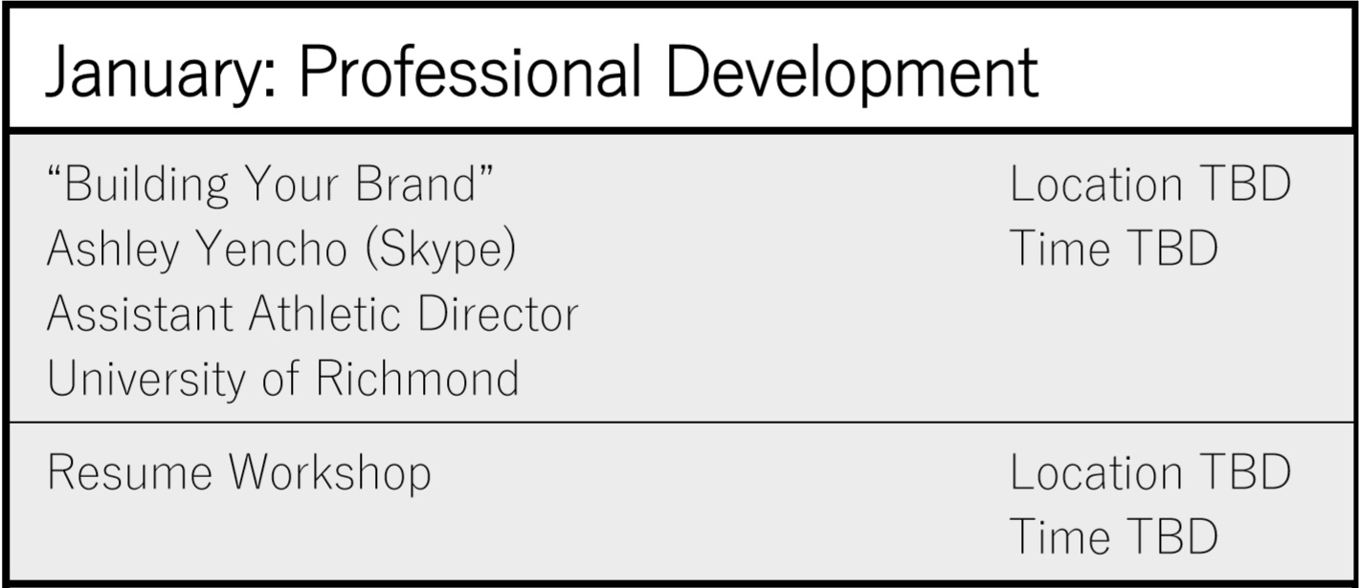
2020 Schedule
Mission | Introductions | Background | Club Offerings | Schedule| Questions
20

Slide 21
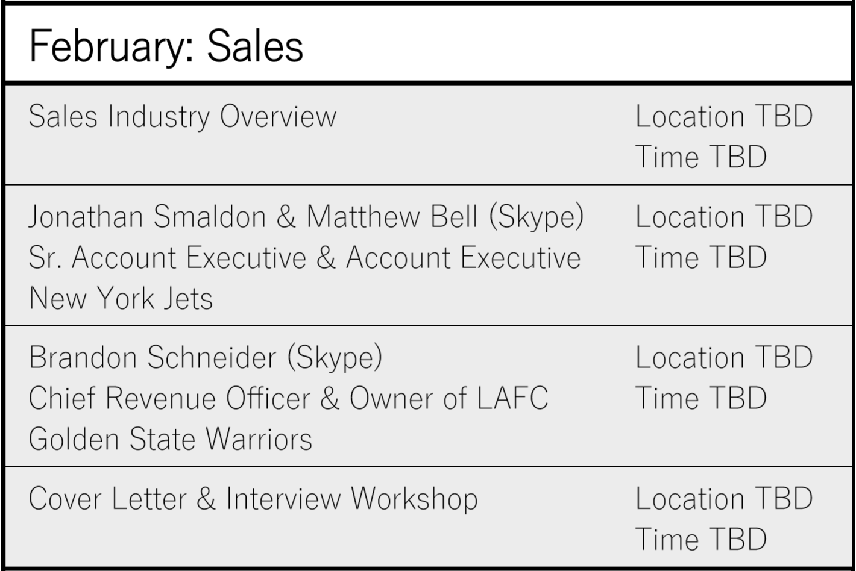
2020 Schedule
Mission | Introductions | Background | Club Offerings | Schedule| Questions
21

Slide 22
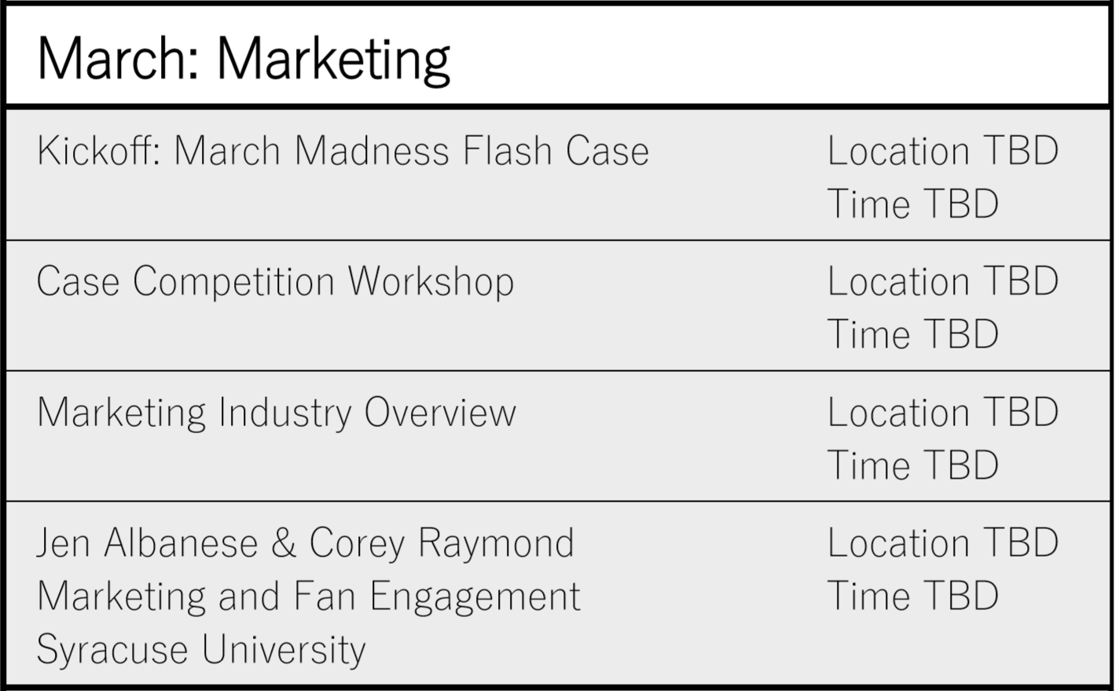
2020 Schedule
Mission | Introductions | Background | Club Offerings | Schedule| Questions
22

Slide 23
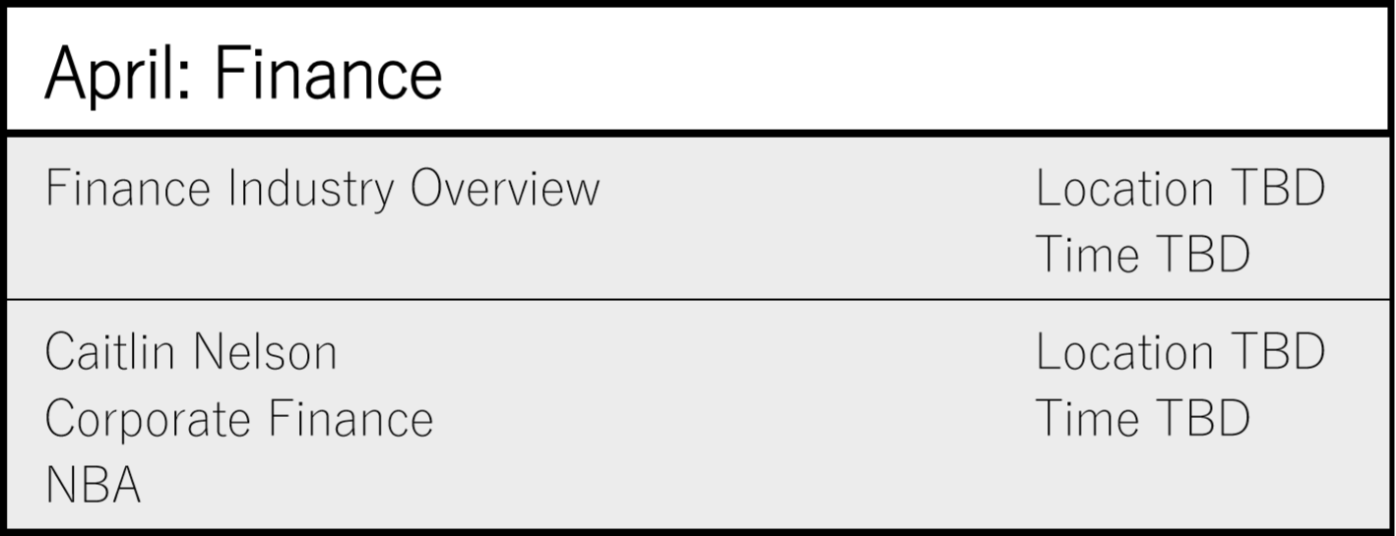
2020 Schedule
Mission | Introductions | Background | Club Offerings | Schedule| Questions
23

Slide 24
2020 Schedule
Mission | Introductions | Background | Club Offerings | Schedule| Questions
24

Slide 25
Questions?

